Slide 1


First-year Achievement Awards
Eerstejaarsprestasietoekennings
Amabhaso eMpumelelo waBafundi boNyaka wokuQala
2018

Slide 2

Die Viserektor Leer en Onderrig, Prof Arnold Schoonwinkel,
bied die Eerstejaarsprestasietoekennings aan die
toppresterende eerstejaarstudente van 2017.
Die rol wat die dosent in hierdie prestasies speel, word ook beklemtoon.
The Vice-Rector Learning and Teaching, Prof Arnold Schoonwinkel,
hosts the First-Year Achievement Awards event for the
top achieving first-year students of 2017.
The endeavour also highlights the role that the lecturer plays in these achievements.

Slide 3
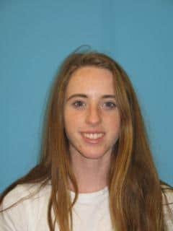
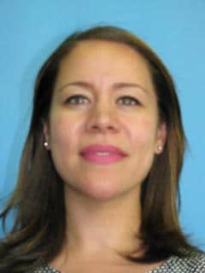
Anja Laubscher (AgriSciences)
It’s inspiring to see how as a young lecturer, you have so much knowledge and you really want to see your students thrive.
Lecturer: Dr D Rip
Ask questions, read to stimulate your mind, engage with people around various topics, take opportunities presented to you (as some opportunities do not always present twice).

Slide 4
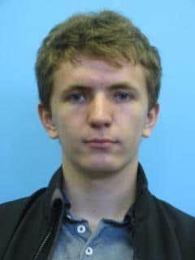
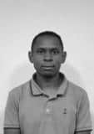
Matthew Brandon (Engineering)
Even with the packed and stuffy classes during the first semester you always managed to spur some life into us with your lively presentations and humorous remarks…
Lecturer: Dr D Ralaivaosaona
Since the day you showed us a solution to that little mathematical problem posed by one of your friends, I knew that I have someone special in my class.

Slide 5
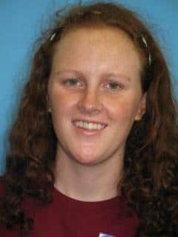
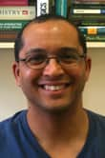
Cecile Bester (AgriSciences)
I have been learning about photosynthesis for my entire life, but never has anyone explained it to me with so much energy as you did. I get chills every time I think about this complex and amazing process.
Lecturer: Prof A Valentine
May you use your knowledge and skills, not only to contribute to the advancement of science, but also to improve the lives of those in society, who do not have access to education.

Slide 6
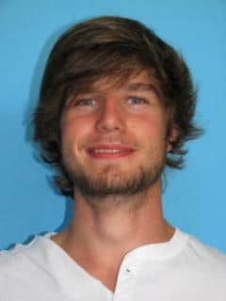
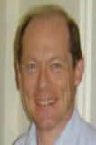
Tyron Cameron (Economic and Management Sciences)
You inspired within me a sense of wonder. Therefore, I have decided to stop calling probability and statistics by its name. These are now quite simply my “magic” classes, (and mathematics is my mathemagic class).
Lecturer: Prof SJ Steel
Tyron, it was a privilege for me to have you in class during 2017. Interacting with a student like you is truly a very rewarding experience for any lecturer.

Slide 7
Behold I do not give lectures or a little charity. When I give I give myself.
Walt Whiteman

Slide 8
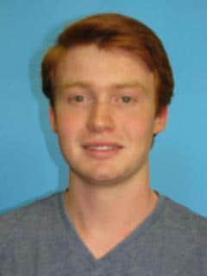
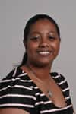
Nicholas Carroll (Law)
Ms Johnson, your exceptional willingness to share your legal experience beyond the lecture subject shows your true passion for the law and legal education. I feel privileged to have benefitted from your instruction and guidance.
Lecturer: Ms E Johnson
[When] students such as yourself ask interesting and relevant questions, and there’s engagement and participation in class, we realise how fulfilling being a lecturer can be… you would pose very relevant questions.

Slide 9
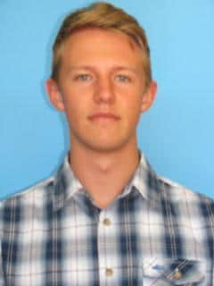
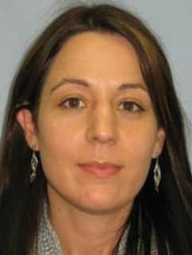
Daniel Claassen (Ekonomiese en Bestuurswetenskappe )
Dit was vir my ‘n groot voorreg om u as my Wiskunde 114-dosent te hê en ek is baie dankbaar vir u bydrae tot my akademiese sukses. Mag u aanhou om studente in hierdie vakgebied so te inspireer!
Dosent: Dr KT Howell
Geluk met jou prestasie, ek is so trots op jou. Ek weet dit het baie harde werk en toewyding geverg. Jy was altyd in die klas, het saam gestrek, saam gelag en saam gewerk.

Slide 10
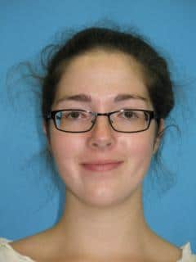

Keilidh Clapperton (Arts and Social Sciences)
Thank you for the respect that you showed each and every one of your students. Thank you for learning our names and our stories, for engaging with us as people with lives and desires, and not just as mere numbers in an institution of so many.
Lecturer: Ms A Daniels
What does surprise me is your decision to allow me to share in this recognition in some small way. Know that I am truly humbled and thank you for this honour.

Slide 11
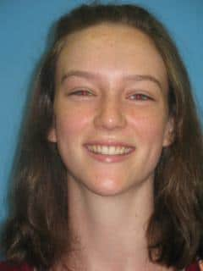

Emma Dachs (Arts and Social Sciences)
Mrs Johnson’s ability to lecture is striking. She enabled me to engage with the content and discover. I felt confident and at ease, as I knew I had been thoroughly prepared. She is an asset to the University of Stellenbosch.
Lecturer: Ms Ebrezia Johnson
I am sure that you made a number of sacrifices during the course of last year, with finding your feet as a first year law student, but by now you must have realised that it was all worth it.

Slide 12
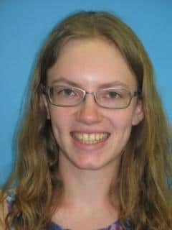
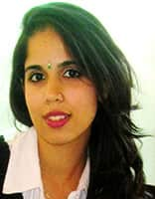
Marguerite Fouché (Arts and Social Sciences)
Even though this year is challenging, I feel prepared because of the things I learned in your class. All the best with your new job and thank you for sharing a part of your time with us last year.
Lecturer: Ms S Delmage
Remember that when learning another language, we broaden our mind and we gain the ability to grow in our career. You have great potential to succeed in life.

Slide 13
“Always pass on what you have learned.”
- Master Yoda to Luke Skywalker in
Return of the Jedi

Slide 14
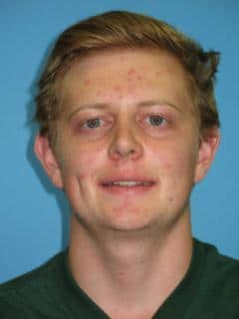

Jordan Haantjies (Economic and Management Sciences)
I appreciated that your assessments were challenging but fair. We were expected to apply the knowledge from the content covered in class and, because this was explained so well, I enjoyed writing the tests.
Lecturer: Prof SJ Steel
Mental power and strength of character also imply responsibility.
This may be your biggest challenge to develop and use your talents
wisely and responsibly, ultimately in the service if society and your
community.

Slide 15
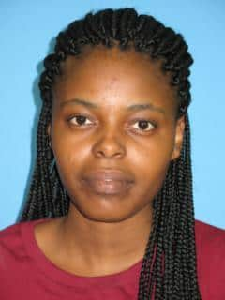
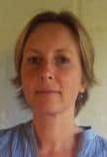
Nqobile Hadebe (Arts and Social Sciences)
I sent you an email to, requesting to have an appointment for assistance with an aspect of the work I was struggling with. It did not take you longer than a few hours to reply to my email, with the welcoming greeting: “Dear Ms Hadebe…”
Lecturer: Prof V Roodt
In participating in this practice (exploration of Physiology), you have become part of the realm of thinkers... You have entered a centuries-old conversation about the fundamental questions of human existence, and you have done so as an equal.

Slide 16
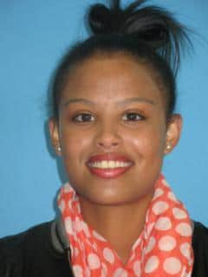
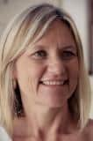
Amy Jefthas (Ekonomiese en Bestuurswetenskappe)
Elke dag was opwindend en elke ervaring was besielend om te beleef… altyd toeganklik en interaktief met die klas en haar wyse van onderrig was uitstekend, omrede na elke lesing was daar geen twyfeling in die inhoud van dit wat aan ons weergee was nie.
Dosent: Dr S Malan
Jou passie vir leer gepaardgaande met jou borrelende persoonlikheid het bygedra tot ‘n heerlike positiewe klaskameratmosfeer vir jou klasmaats sowel as vir my! In die flip klaskamer was jy dikwels die beste voorbereide student in die klas.

Slide 17
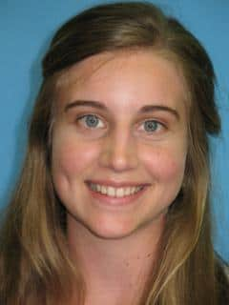

Lané Katzke (Education)
And ultimately, deciding on a lecturer I had received less than two months of class from is, I suppose, a little unconventional. But I think there is something to be said for teachers who can reach out and somehow inspire the souls of their students.
Dosent: Me S van Craenendonck
Ik wil je ook heel erg bedanken dat ik deze feestelijke avond samen met jou mag delen. Het is een hele eer voor mij dat jij mij hebt gekozen. Ik heb met heel veel plezier het vak “Inleiding tot Nederlands” gegeven en ik ben blij dat jij ervan genoten hebt.

Slide 18
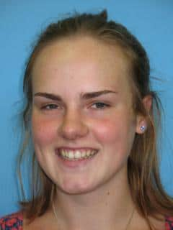
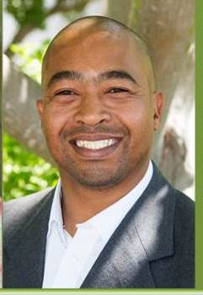
Yvonne Louw (Health Sciences)
I had no need for a lecturer who would remind me of how difficult the course is or push me to attain excellence. I needed someone who was set on making a difference in the lives of patients and students alike. Amid my anxiety, I met Mr Fredericks, one of the friendliest faces I have ever seen.
Lecturer: Mr J Fredericks
Remember at university, you are representing yourself, your family, your school and community, so make the nation proud. The best is yet to come and always believe in your dreams.

Slide 19
“It is through education that the daughter of a peasant can become a doctor, the son of a mineworker can become the head of the mine, that the child of farm workers can become the president of a great nation.”
Nelson Mandela

Slide 20
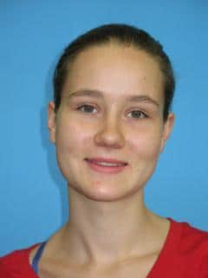
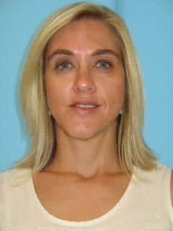
Manuela Vente (Natural Sciences)
Your kindness and the fact that you knew me by my name gave me comfort. Getting to know a lecturer in the way that I met you also helped me to address other people which guided me towards achieving my personal ambition.
Lecturer: Ms Z Bester
You made an appointment to discuss how you could do better in your work. I would want others to adopt this quality as well: to know that asking for advice is a way of empowering yourself and adding to your knowledge and skills – not a lack of strength.

Slide 21
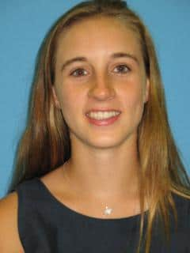
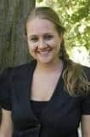
Hanne Mertens (Economic and Management Sciences)
You have made a massive impact on my passion for the subject through your energetic enthusiasm and dedication - for accounting, for lecturing and for your students and you never treat us as just another student number.
Lecturer: Ms M Rossouw
First year ensures that your foundation is solid - now you just need to keep building on that. Also make sure to consult your lecturers – it is better to settle issues earlier rather than later.

Slide 22
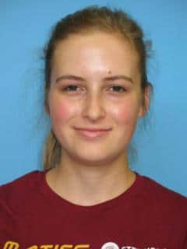
Jacobie Mouton (Natuurwetenskappe)
Iemand wat ’n konneksie kan maak met haar klas en elkeen soos ’n individu kan laat voel, nie net nog ’n gesig in die rye banke nie. U is só ’n dosent.
Dosent: Dr KT Howell
Ek sien dit as ‘n besonderse voorreg om elke dag iets te doen waarvoor ek lief is… Om dan ‘n student soos jy te hê, wat bereid is om hard te werk, en nie moed op te gee nie, maak dit nog meer die moeite werd.

Slide 23
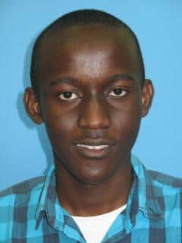
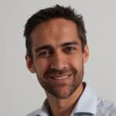
Alex Gituanja (Engineering)
As I was studying in Kenya, resources and time were scarce. Programming was not part of the syllabus… so I was a bit disappointed to have to wait till the second semester for the
module but it was worth the wait.
Lecturer: Prof MJ Booysen
I am fully aware that, despite clearly having been blessed with a sharp intellect, this achievement has not merely landed in your lap, and probably required a lot of hard work from you. I want to assure you that continuation of this work ethic will serve you well.

Slide 24
“One looks back with appreciation to the brilliant teachers, but with gratitude to those who touched our human feelings.”
Carl Jung

Slide 25
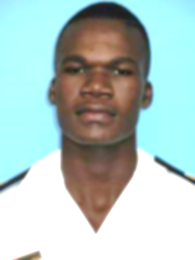
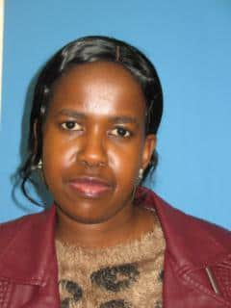
Khethukuthula Nxumalo (Military Sciences)
It was not a friendly environment but you made not my life but our lives easier to cope within such an environment. You started by building a strong foundation and thereafter you spent most of your time with us in class whenever needed.
Lecturer: Ms MV Theletsane
This celebration is a hallmark of your dedication and hard work. It did not come as a surprise at all that you achieved this excellence, you have aways taken responsibility of your own learning.

Slide 26
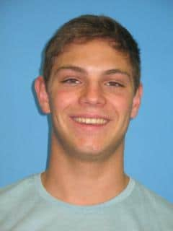
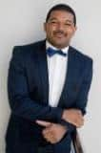
Willem Odendaal (Economic and Management Sciences)
You were an inspiration to me throughout the entire 2017 year. To see someone with such a passion for his work, inspired me to one day have the same passion towards my job. You have such a great understanding of the course content and have a unique and practical way of teaching it to your students.
Lecturer: Mr A de Laan
I'm so proud of you for setting your sights high… This achievement will serve as evidence of your immense potential and should afford you many future opportunities.

Slide 27
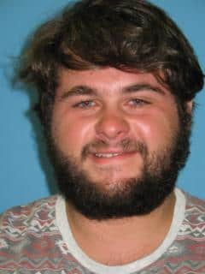
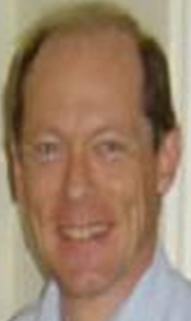
Leon Rossouw (Economic and Management Sciences)
Professor wanted to be there and wanted to help us… your words of encouragement before formal assessments, your revision lectures and the additional material you provided in preparation for the upcoming assessment, made such a big difference.
Lecturer: Prof SJ Steel
There are several requirements for a student to be as successful as you have been. You are exceptionally intelligent and talented, but these qualities alone cannot guarantee achievement. One also has to be focussed and highly motivated.

Slide 28
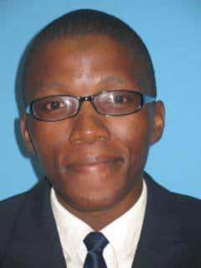
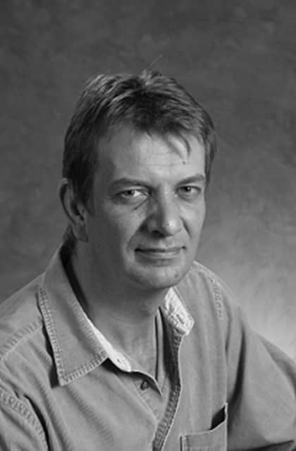
Mnedisi Sibiya (Health Sceinces)
Your sense of purpose and love for what you do is what caught my attention the most. The manner in which you deliver your lectures is very unique and absolutely amazing. I would like to convey my heartfelt gratitude for the impact you had in my academics
Lecturer: Prof H Strijdom
After having had a personal conversation with you recently, I realised that YOU are the star of this show. Words cannot express the respect and admiration I have for you… your ability to find the resolve to be a top academic achiever in a class of 400 bright students. How proud your family and community must be of you. And so am I.

Slide 29
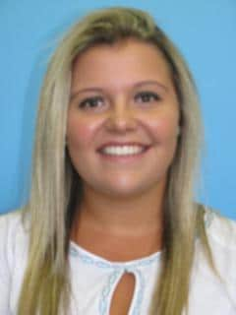
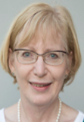
Karla Smit (Theology)
Wat ‘n eer was dit om by so ‘n legende klas te kon hê. Sy is ‘n inspirasie vir alle mense – vir elkeen wat streef om ‘n goeie mens te wees, iemand wat ‘n goeie en gelukkige lewe wil lei deur ander te help en om ander gelukkig te sien.
Dosent: Prof A Kotzé
Ek voel ook besonder bevoorreg dat jy my reken as iemand wat ŉ bydrae tot jou sukses gemaak het; dít terwyl jy een van daardie studente is wat ook sonder ŉ dosent die materiaal uitstekend sou bemeester het!

Slide 30
“Education is the most powerful weapon you can use to change the world.”
Nelson Mandela

Slide 31
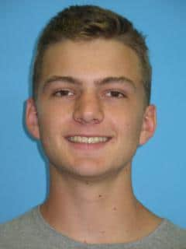
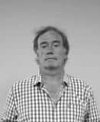
Zander Snel (Engineering)
Due to the large size of the engineering class we had limited interaction yet you impacted each of the students who were willing to learn. Your subtle humour very effectively helped keep the class focussed. You showed us concepts which would not be tested about the history and development of mathematical ideas and models.
Lecturer: Prof M Wild
I wish you much success in your future studies and may mathematics always enrich your life!
Being with improvised puns, or with the yearly standard jokes, such as encouraging you to discuss (1+2+….+n)² = 1³+2³+….+n³

Slide 32
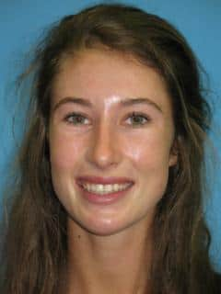
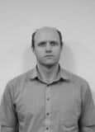
Jamie Stolk (Economic and Management Sciences)
Your enthusiasm, positivity and readiness to help wherever needed was noted. The extra enrichment classes offered showed your passion for the subject, and a keenness to share it with your students.
Lecturer: Dr J Gray
I recall from the lecturers that you were attentive, focussed, and willing to participate. Your marks of 90% and 99% for the respective mathematics modules suggest that you are both talented and hard working.

Slide 33
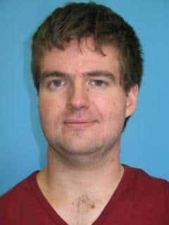
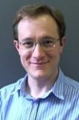
Conrad Strydom (Natural Sciences)
I realize that most of my lecturers worked tirelessly towards ensuring the highest quality of education… but until your lectures I did not fully understand all the concepts. The many challenging concepts were explained very well in a very short time.
Lecturer: Dr JN Kriel
I am very happy to hear that you found our physics courses to be an enriching experience. Students of your calibre really make the task of teaching a pleasure and a continued source of inspiration.

Slide 34
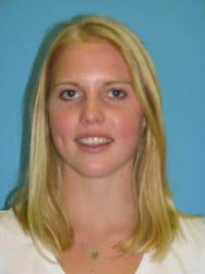
Cayley Tarr (Economic and Management Sciences)
In that one lecture you taught me to think for myself; to not blindly accept what I’m told and to approach lectures with an enquiring mind. It is the most important skill that I’ve been taught in my university career by far, and I’m very grateful that I was taught this so early on.
Lecturer: Mr A de Laan
Thank you for identifying me as someone who had an influence on your success. It is one of my life goals to make the study process as straightforward as possible and it warms my heart to receive such commentary form one of my students.

Slide 35
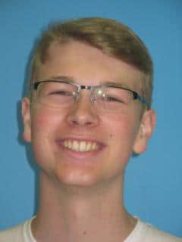
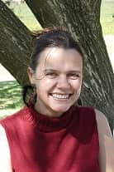
Dylan Thwaits (Arts and Social Sciences)
After being told we would need to converse with our lecturers in French at the end of the year, I thought there was no conceivable way this could happen. Learning a new language at a university level is frankly terrifying. Yet you made the transition pleasant and enjoyable.
Lecturer: Dr J Steyn
If you stay unwavering in your commitment towards your studies and continue to put in the same level of effort on a continuous basis, I am sure that there will be many similar achievements to follow. Be curious. Make your world as wide as possible.

Slide 36
“No two persons ever read the same book.”
Edmund Wilson

Slide 37


Dario Trinchero (Natural Sciences)
Do not think that the energy, which you dedicate towards hand-selecting material, suited to my level and interest, tracking my progress therein, and making yourself available to discuss content go unappreciated.
Lecturer: Dr Bruce Bartlett
I have no doubt that you will make a brilliant mathematician if that is what you want to do! But your options are many and you still have much time, so keep doing what you are doing.

Slide 38


Jana van der Westhuizen (Ekonomiese en Bestuurswetenskappe)
Ek herroep hoe elke vorderingsvraag “’n lekker vraag” was. Soms is passie al wat nodig is om studente te oortuig dat hul óók ‘n liefde vir ‘n vak kan ontwikkel. Dit gee hul ‘n hupstoot om struikelblokke met meer selfvertroue aan te pak en gedetermineerd te oorkom.
Dosent: Me S Smit
Moet nooit moed opgee nie. BRek het maar die geneigdheid om mens soms te wil onderkry, maar byt net vas! As gekwalifiseerde GR(SA) gaan jy ŉ positiewe impak op ons samelewing kan maak, en ons het goeie leiers soos jy nodig.

Slide 39

Bianca van Zyl (Engineering)
The increase in the pace at which content is covered at university was particularly noticeable to me in the Engineering Maths modules; however, I found your teaching style to be very effective despite this. Thank you for all the effort you put into lecturing.
Lecturer: Prof M Wild
Thank you for that honour! I assume, but am not sure, it is because I often point out that math can be fun. At an advanced age I still listen to Deep Purple, Moody Blues, Michael (and Millie) Jackson.

Slide 40


Christine Vivier (Health Sciences)
Working through a stack of lectures and happening upon one of your classes was always accompanied by a sense of “Oh, good, it is Dr Shani’s notes. There is hope for this section yet!”.
Dosent: Me S Dames
Mag dieselfde passie en doelgerigtheid jou voete lig laat voel soos jy die pad aanpak wat lei na insig, geleenthede en ŉ blink toekoms! Ek sien daarna uit om jou van tyd tot tyd op hierdie pad raak te loop.

