Slide 1


First-year Achievement Awards
Eerstejaarsprestasietoekennings
Amabhaso eMpumelelo waBafundi boNyaka wokuQala
2017

Slide 2
Die Viserektor Leer en Onderrig, Prof Arnold Schoonwinkel,
bied die Eerstejaarsprestasietoekennings aan die
toppresterende eerstejaarstudente van 2016.
Die rol wat die dosent in hierdie prestasies speel, word ook beklemtoon.
The Vice-Rector Learning and Teaching, Prof Arnold Schoonwinkel,
hosts the First-Year Achievement Awards event for the
top achieving first-year students of 2016.
The endeavour also highlights the role that the lecturer plays in these achievements.

Slide 3
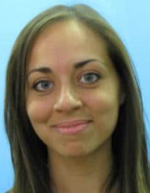
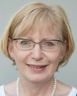
Juanita Cilliers (Lettere en Sosiale Wetenskappe)
Enige student wie van beterskap kan getuig … sal dit toeskryf aan die onderwyser se bereidheid om die ekstra myl saam met die student te loop. In my akademiese loopbaan tot nou staan u uit as daardie lektor vir baie meer redes as een.
Dosent: Prof Annemaré Kotzé
Dit was vir my ŉ groot vreugde en baie bevredigend om jou besondere taalaanleg te sien ontwikkel. Om enige iets te verduidelik vir iemand wat met soveel verwondering en toewyding aan die proses deelneem, is louter genot.

Slide 4
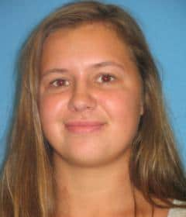

Jette Kirsten (Arts and Social Sciences)
The first semester of introductory Microeconomics by Ms Ingrid de Waal had me hooked … lecturers facilitate learning by allowing those that they teach to explore who they are and what they would like to be.
Lecturer: Ms Ingrid De Waal
A great man called Dumbledore once said, “Help will always be given at Hogwarts to those who ask for it”. Stellenbosch is filled with lecturers and students who readily offer their help if you need it, and I urge you to not be shy about reaching out.

Slide 5
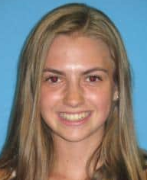
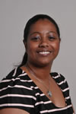
Carma Botha (Lettere en Sosiale Wetenskappe)
Die moeite wat u gedoen het en die tyd wat u ingesit het, was ten alle tye sigbaar. U was altyd deeglik voorbereid en elke lesing het ŉ spesifieke en sinvolle uitkoms gehad ... Dat u ŉ kenner in die inheemse reg genooi het om vir ons ’n lesing daaroor aan te bied.
Lecturer: Ms Ebrezia Johnson
[W]hen students such as yourself ask interesting and relevant questions, and there is engagement and participation in class, we realise how fulfilling being a lecturer can be. You will also enjoy studying law and see how the law can be used to actively change and better the lives of all South Africans.

Slide 6
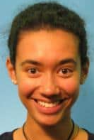
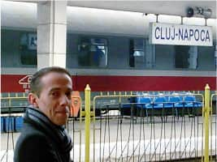
Ashleigh Thompson (Arts and Social Sciences)
[T]hank you for creating a warm, welcoming environment within our French class … this softened the many blows French grammar had thrown at us … anecdotes from your youth and life in France, our classroom was regularly transformed into “une petite France”.
Lecturer: Dr Éric Levéel
Your true passion for French and your bright curious mind have everything to do with your success. If I were of any help to you, it was simply in ensuring that your curiosity was stimulated and that your passion for my language was always fueled ... Je vous souhaite tous les succès possibles et je suis ravi que vous continuiez le français cette année.

Slide 7
Behold I do not give lectures or a little charity. When I give I give myself.
Walt Whiteman

Slide 8
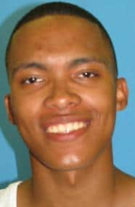
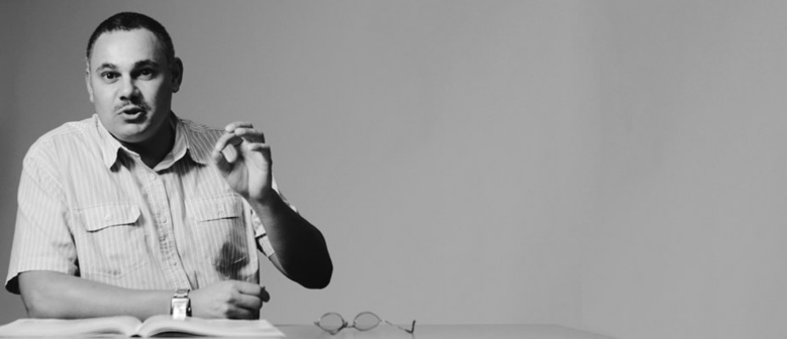
Adonis Willan (Arts and Social Sciences)
You are clearly a lecturer who knows how to make his students think and question the world in which they live – I am convinced that this is your way of crafting the responsible citizens you wish for us to become.
Lecturer: Dr Manfred Spocter
I know you as an intrinsically-motivated student who constantly strives to deliver the best. Never give up, persevere and remember that Stellenbosch University lecturers are always there for you to consult with.

Slide 9
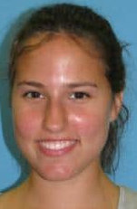
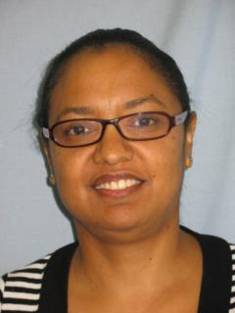
Ingrid Grundling (AgriWetenskappe)
U het ‘n blywende indruk op my gemaak, en ek sal altyd met goeie herinneringe terug kan dink aan my eerstejaar, en aan die wiskunde lesings wat vir my ‘n hoogtepunt van die akademiese week was.
Dosent: Me Lesley Wessels
Wiskunde was nie een van jou hoofvakke nie, maar dit blyk dat jy dit met dieselfde toewyding aangepak het. Dit is ‘n eienskap wat jou goed sal dien in ander aspekte van jou lewe, naamlik, dit moet nie saak maak hoeveel krediete iets tel nie.

Slide 10
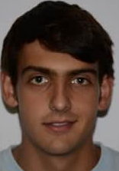
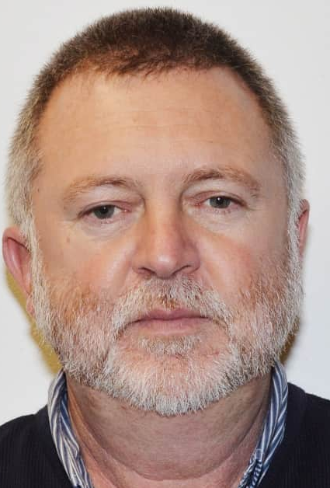
Adriaan Joubert van Wyk (AgriWetenskappe)
Buiten die feit dat meneer ŉ absolute meester is in die grondkunde veld is meneer ‘n persoon, wat die kuns vermag het om meneer se liefde vir grondkunde te laat oorspoel na my en die ander studente van my klas.
Dosent: Mr Nelius van Huyssteen

Slide 11
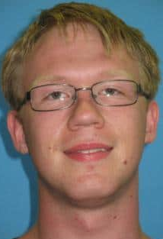
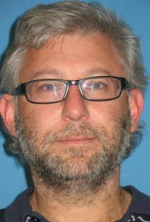
Johannes Coetzee (Natural Sciences)
Your enthusiasm was evident throughout ... I was eager to attend your classes, simply because they were fun to attend. Because of this, my own enthusiasm grew as well and, by the end of the year, computer science had become one of my favourite subjects.
Lecturer: Prof Jaco Geldenhuys
You probably know by now that just being very talented is not enough: hard work is an essential element of success at this level. Your performance bears witness to both your talent and your dedication to your studies.

Slide 12
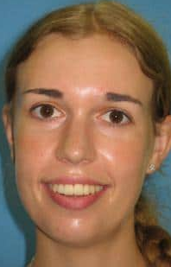
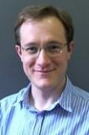
Emma King (Natural Sciences)
I truly respect your willingness to assist me, and other students, whenever we needed help … never just provided answers but rather hints as to where I should start or what I should focus. It also taught me how to persevere and consistently try my best.
Lecturer: Dr JN Kriel
Congratulations on a very successful start. It is seldom that a student’s interest, ability and attitude align so well, and it is even rarer for these to flourish despite challenging circumstances.

Slide 13
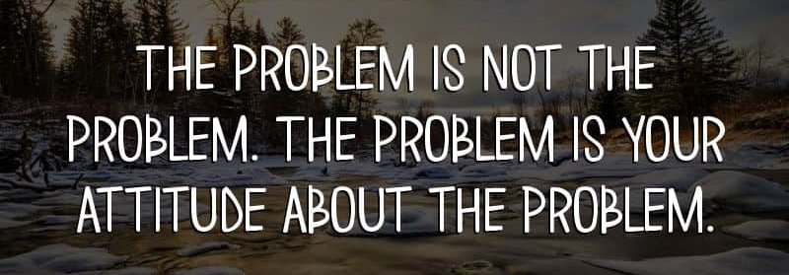
Captain Jack Sparrow, (Pirates of the Caribbean)

Slide 14
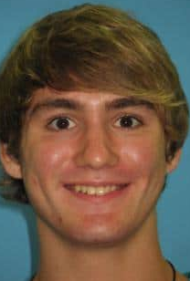
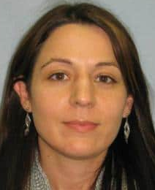
William Mey (Natuurwetenskappe)
[A]lles vanaf “inspirational movies” tot die deurdagte aankope van stewels vir die winterreën het aan ons humor en wysheid verskaf. [L]esings en notas goed beplan … die ekstra myl geloop om ons te help… en selfs die vrymoedigheid gehad om saam met ons ‘n klasfoto te neem.
Dosent: Dr KT Howell
Jy het geskryf: “Ek sal my doelwit bereik deur vrae te vrae en ekstra werk te doen as ek sukkel, asook my tyd deeglik te beplan.” En jy het dit gedoen! Jou dissipline en harde werk sal jou in die toekoms help om groter hoogtes te bereik.

Slide 15
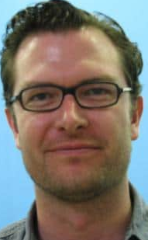
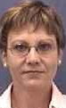
Freddie de Villiers (Natural Sciences)
[Y]ou told us not to get flustered, to stay calm, to engage with and approach [a maths problem] from different angles to see where it may lead us. If one tried today and failed, one could return tomorrow in good spirit and chip away at it some more.
Lecturer: Prof Ingrid Rewitzky
As you embark further on your journey of mathematical sciences, keep curious, ask good questions, think deeply and creatively, stimulate your mind by reading, make mistakes, have self-confidence, and never give up.

Slide 16
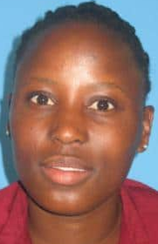
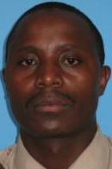
Thamaga Kgabo (Military Science)
You were the one lecturer that made everything look simple and you motivated me to work extra, smarter and harder. You always encouraged us to not lose focus … so I was inspired to also make it this far.
Lecturer: Capt Ramotjaki Lucky Monaledi
I said during the Mathematics Refresher Course, ‘Life is like a wheelbarrow; nothing will happen, unless you start pushing’. Don’t stop soldiering on. Pursue your studies with your own brand of commitment and determination and success will come to you.

Slide 17
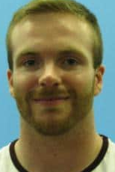
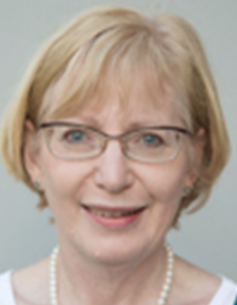
Matthew Clark (Theology)
You are very interested in your students and are eager to help them learn from their weaknesses and grow. Knowing this, I could email you with questions, and felt more comfortable in class, able to speak up and clarify any certain problems that I came across.
Lecturer: Prof Annemaré Kotzé
Academically you always impressed with your very precise grasp of what you understood at first glance and where slight intricacies presented themselves, as well as with your commitment to sort out such issues in conversation with me and your class mates.
May you continue to be enriched by what South Africa has to offer.

Slide 18
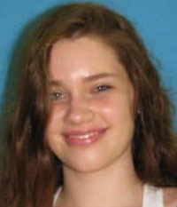
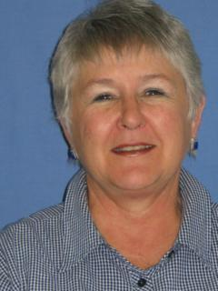
Stefanie Kotzé (Law)
You never tried to have the aura of perfection and that made everyone in the class, relate to you more. Mutual respect formed because we knew that we are only human, we all have terrible days and all make mistakes, but because we have compassion for each other we accept the bad because we understand.
Lecturer: Ms Carina Malan
Stefanie is exceptionally intelligent and gifted. But this is not enough for academic success. She prepares for classes, attends each one and after class makes sure that she understands what was discussed … plans ahead and uses her time effectively.

Slide 19
It is through education that the daughter of a peasant can become a doctor, the son of a mineworker can become the head of the mine, that the child of farm workers can become the president of a great nation.
Nelson Mandela

Slide 20
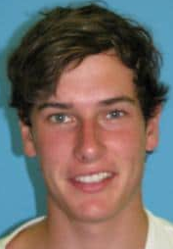
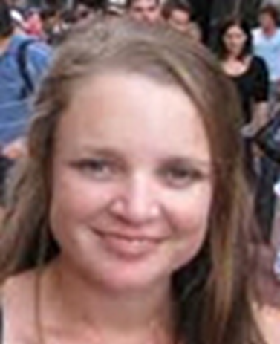
Sam Jeffery (Engineering)
Applied Maths was one of the only subjects that I had never studied anything similar to before but thanks to you I bridged the gap. You presented the work in such a way that nothing ever seemed to fall through the cracks.
Lecturer: Dr Riana Roux
It is hard work, determination and a love for what you are doing (and a joke every now and then) that will bring you success in life. Keep up the excellent work and never lose the drive that brought you here.

Slide 21
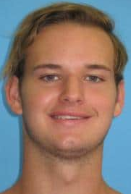
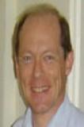
Jason Evezard (Economic and Management Sciences)
You have made a lasting impression on me and many students before me, and will undoubtedly continue to leave a lasting impression on future students fortunate enough to be lectured by you.
Lecturer: Prof SJ Steel
Mental power and strength of character imply responsibility. This may be your biggest challenge: to develop and use your talents wisely and responsibly, ultimately in the service of society and your community. I have absolutely no doubt that you will be successful in this .

Slide 22
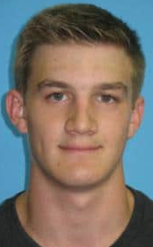
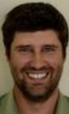
Brandon Wallis (Engineering)
In my experience, Prof Boshoff created a fun filled class environment to motivate and encourage us, as his students, to listen to what he has to say and also to attend all the classes that he lectured.
Dosent: Prof Billy Boshoff
Dit is my wens vir jou, mag jy dit regkry om jou talent en wiskundige modelle te gebruik om ‘n verskil in ander mense se lewens te maak. Direk of indirek, dit maak nie saak nie.

Slide 23
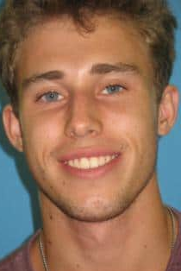
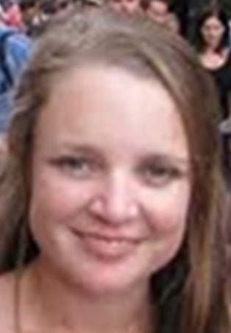
Vincent Clarke (Engineering)
You always had a clear plan as to what you wished to achieve in a lecture. The videos were also amazing… the tiny details that you taught us in order to make the problems easier. All the times that your computer gave trouble [but] you continued to make the videos just proves how much dedication you have towards your students.
Lecturer: Dr Riana Roux
You have the ability to reach great heights. Nurture it, develop it and do not lose sight of your goals. Let you achievements serve as reminder of what you are capable of doing and let your failures serve as a reminder of what you are capable of overcoming.

Slide 24
One looks back with appreciation to the brilliant teachers, but with gratitude to those who touched our human feelings.
Carl Jung

Slide 25
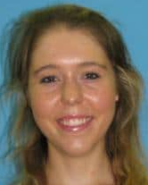
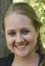
Christine Brokensha (Economic and Management Sciences)
I could clarify any question I had and would receive such a fast and detailed response. You would congratulate me if I did well in a test, adding such a personal touch, especially when you are in a lecture hall of 400 students.
Lecturer: Ms Mareli Rossouw
My advice to you is to work hard throughout the year and to make sure that you spend enough time on exam technique to ensure that your results reflect your knowledge of the work. I know that you have a great foundation from first year - now you just need to keep building on that.

Slide 26
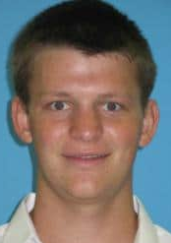

Jakobus Murray Louw (Ingineurswese)
U het waarlik omgegee oor die klas en dit het dit sommer lekker gemaak om selfs Maandae om 8uur klas by te woon. Dit was vir my ongelooflik hoe u so mooi en geduldig kon verduidelik aan studente wat sukkel om iets te snap.
Dosent: Dr Riana Roux
Om suksesvol te wees in hierdie wêreld moet mens lief wees vir wat jy doen, jy moet nie bang wees vir harde werk nie en jy moet vasbyt tot die einde. Ek glo dat jy besonders suksesvol gaan wees met jou studies en in jou loopbaan vorentoe.

Slide 27
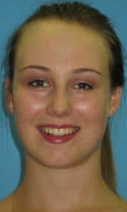
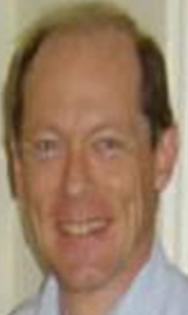
Danielle Vellema (Economic and Management Sciences)
I am inspired to be able to understand all my work so thoroughly that I can explain even some of the most complicated ideas in a way such that even an unenlightened, innocent first year can understand exactly what I am talking about – because that is exactly what you do.
Lecturer: Prof SJ Steel
You are obviously exceptionally intelligent and talented, but these qualities alone cannot guarantee achievement. One also has to be focussed and highly motivated to achieve one’s goals. It is clear from the marks that you obtained in 2016 that you have been able to put this into practice.

Slide 28
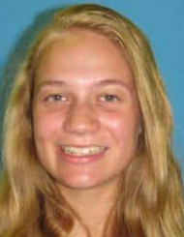

Lara-Mari Loock (Economic and Management Sciences)
I am not sure what intrigued me the most … The stretching sessions halfway through classes, the eagerness of taking class photos or the ease and simplicity in the way you taught. It is evident that you have a heart that strives to serve ... you truly understand the essence of how a lecturer can impact students in a broader way than just getting them through a course.
Dosent: Dr KT Howell
90% vir Wiskunde 144 is ‘n besonderse prestasie en een wat ek weet baie harde werk en toewyding geverg het. Ek weet jy was altyd in die klas, het saam gestrek, saam gelag en saam gewerk. Klasgee is my passie en om deel te wees van ‘n student se sukses is ‘n groot eer.

Slide 29
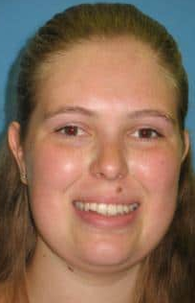
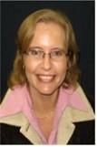
Anél Swanepoel (Ekonomiese en Bestuurswetenskappe)
‘n Mens kan ‘n spesialis op jou gebied wees, maar dit vereis ‘n spesiale talent om kennis te kan oordra. U kon ‘n moeilike konsep afbreek tot in die eenvoudigste detail sodat ek dit makliker verstaan. Dit het ook tot die gevolg gehad dat ek ander studente kon help... en dit het bygedra tot my sukses.
Dosent: Me Sybil Smit
Daar is heelwat raad wat ek kan aanbied om te verseker dat jy aanhou om sukses te behaal: werk deurlopend, en wees voorbereid vir elke lesing, moet nooit huiwer om jou dosente te gaan sien as jy onseker is nie (dit is een van die foute wat ek as student gemaak het).

Slide 30
Education is the most powerful weapon you can use to change the world.
Nelson Mandela

Slide 31
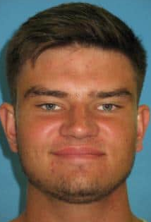
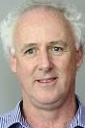
Louis Schoonwinkel (Economic and Management Sciences)
I will never forget the seriousness of tone in which you told us at the beginning of the year that we will not become actuaries if we do not work extremely hard. It incited a certain pride within me for being able to call myself an actuarial science student.
Lecturer: Prof G Slattery
Your success will have been due, in no small part, to your strong work ethic and organisational ability. Such an attitude, and enthusiasm to engage with new material, should stand you in good stead to tackle the academic demands that lie ahead in this course of study.

Slide 32
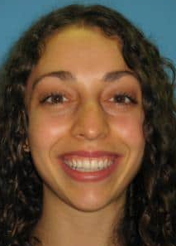

Marilie Matthee (Economic and Management Sciences)
Thank you for inspiring me to become the best person that I can be. I still remember the first day that you lectured me. I was in complete awe of how well and clear (and fun) you explained the financial accounting principles. Your love and passion for your subject and our class was so evident in everything that you did.
Dosent: Me Mareli Rossouw
My uitnodiging na die Eerstejaars Prestige-aand is nog die beste e-pos wat ek in hierdie tyd ontvang het! Ek weet jy het alreeds ‘n goeie fondasie gelê in 2016 en dat jy nie sal huiwer om dosente te nader indien jy onseker is oor iets nie. Ek wil jou aanmoedig om asb aan te hou om hulle te vra!

Slide 33
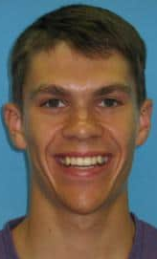
Luke Nel (Economic and Management Sciences)
Your attention to detail and structured way of lecturing suited me perfectly and made it a pleasure to cooperate in lectures and preparing for tests. Your thorough approach and many example questions made me a better mathematician and it stimulated my interest in the subject.
Dosent: Dr KT Howell
Ek sien dit as ‘n besonderse voorreg om elke dag iets te doen waarvoor ek lief is en om studente soos jy te hê. Ek wens jou alle voorspoed met jou toekoms. My hoop is dat jy ‘n beroep sal vind waarin jy jou talente kan gebruik en jou passie kan uitleef.

Slide 34
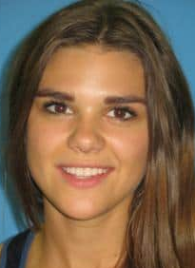

Gitte Ter Borg (Economic and Management Sciences)
I applaud the amount of time and care you put into your students and their achievements. It did not go unrecognised and I can promise you, there are many others that owe you thanks for pushing us to better ourselves and also for enabling us to do so.
Dosent: Me Liezl Nieuwoudt
Veral dankie vir jou heelhartige deelname aan die flipped Ekonomie-klas verlede jaar; ek wil glo dat dit bygedra het tot meer as net jou leer van die Ekonomie inhoud – dat dit ook jou besondere ingesteldheid tot die wêreld om ons versterk het en jou meelewing gefasiliteer het.

Slide 35
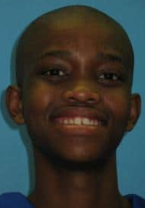

Curtley Olyn (Economic and Management Sciences)
Remy’s words were so inspiring. She reminded me of what I was working towards; that it will take time to fully adapt to University; to keep on making sacrifices; to keep on bearing disappointments because when I walk into that audit firm one day it would all have been worth it. I would forget about the late nights and the bad times.
Lecturer: Ms Remertha Basson
If you stay unwavering in your commitment towards your studies and continue to put in the same level of effort on a continuous basis, I am sure that there will be many similar achievements to follow.

Slide 36


Slide 37


Chané Terblanche (Opvoedkunde)
Sy goeie sin van humor het die klas van die begin af gemaklik laat voel en hy het ook voorgekom as ‘n baie toeganklike mens wat oop sal wees vir nuwe idees en voorstelle. ‘n Mens kon in sy werkstrukturering en aanbiedinge sien dat hy wel baie moeite gedoen het om die werk so interessant as moontlik te hou.
Dosent: Mnr Marius Swart
Hou asseblief aan om die intelligente, vriendelike, flukse en innemende persoon te wees wat jy tot dusver was. Jy is ŉ uitsonderlike student, maar meer as dit is jy ŉ uitsonderlike méns. Onthou op jou pad vorentoe hierdie aand en wees trots op jouself.

Slide 38


Theresa Brummer (Health Sciences)
Your wit and energy in the lecture hall made every lecture a highlight and made learning a dynamic process that pushed me to think and understand new concepts. The time that we had with you in the lecture hall also made me realise an important thing: learning and the process behind it is what I make of it.
Lecturer: Prof H Strijdom
Jou prestasie kan nie regtig ten volle na waarde geskat word nie – jy bevind jouself in ‘n hoog kompeterende omgewing tussen ander begaafde en intelligente eweknieë. Daar is soveel druk op julle. En dat jy dit nogtans reggekry het om so te presteer, verdien die hoogste respek.

Slide 39


Gaby Rautenbach (Health Sciences)
Thank you for the well-structured lectures and how interactive you made them, because it highlighted how valuable it is to actually attend lectures and take part in what is being taught. These lessons I learnt from you did not only influence my first year of studying, but will continue to be remembered throughout my studying career and life.
Lecturer: Dr PH Neethling
Always set yourself goals, but ensure that they are realistic. Remember to tick off these goals as you achieve them. You will be amazed at how much satisfaction one can get from looking at a completed list of tasks and goals!

Slide 40


Nazley Wilschutt (Lettere en Sosiale Wetenskappe)
Anita het ons geleer hoe om die onderwerpe wat ons in die klas behandel het, in konteks met die daaglikse samelewing te bring. Daar was dae waar sy hard op my sowel as my medestudente was, maar sy wou hê elkeen van ons moes ons volle potensiaal bereik; dit waartoe ons in staat is.
Dosent: Dr Anita Jonker
Jy het reeds lank gelede die besluit geneem om deur harde werk en ‘n positiewe ingesteldheid jou studiedoelwitte te bereik. Jy gryp elke enkele geleentheid aan om te leer en hierdie leergierigheid gaan uiteindelik jou sukses in ‘n akademiese loopbaan verseker.

Slide 41


Lebohang Likole (Health Sciences)
For the entirety of our first year, you frequently came to check if we were still doing fine, attended to our concerns, organized one-on-one contact sessions to see how we were coping. With every conversation I had with you, I became a better person. Thank you for making my transition from high school to gap year, then university, a smooth one indeed.
Lecturer: Dr Alwyn Louw
Characteristics of you standing out are your punctuality, self-assertiveness, being goal- driven, respectful and hard working. These characteristics will make a great success as a medical student as well as your career as a medical practitioner. You grabbed the opportunity when selected into the medicine programme, and are an inspiration to your peers!

