Slide 1

First-year Achievement Awards
Eerstejaarsprestasietoekennings
Amabhaso eMpumelelo waBafundi boNyaka wokuQala
For academic year 2019
Presented on 20 May 2020

Slide 2
Top Achieving First-Year Students 2019
Laura Badenhorst | Tara Grobbelaar | Lizè Myburgh
Karabo Bapela | Jessica Hillier | Julia Snyckers
Rehab Botlholo | Bradley Jacobs | Wicus van der Linden
Jason Brown | Hans-Christoph Lange | Suné van Dyk
Tiaan Cilliers | Peng-Chen Liang | Slade van Rooyen
Pieter Conradie | Danielle Louw | Megan van Schalkwyk
Christa-Mari de Lange | Zoë McCathie | Brendan Watling
Tanitah Deyzel | Ralph McDougall | Matthew Wille
Helette du Plessis | Nur-Ayn Mohamed | Jacques Wust
Jean Durand | Petronè Moolman | Suewellyn Zimmermann
Karli du Toit | Thando Mtimkulu

Slide 3
Nominated Lecturers 2019
Alex Andrason | Sonia Human | Michael Schmeisser
Léa Benabdelghaffar | Doret Jordaan | Debra Shepherd
Amy Daniels | Herman Kamper | Garrett Slattery
Andrew Fransman | Erna Lampen | JP Smit
Jerome Fredericks | Anieka Malan | Sybil Smit
James Gray | Sophie Marques | Marie-Anne Staebler
Helena Heath | Jacques Masuret | Hans Strijdom
Debbie Horsten | Eva Nel | Modiehi Theletsane
Karin-Therese Howell | JC Rademeyer | Hugo Touchette

Slide 4
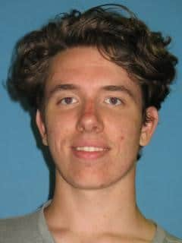
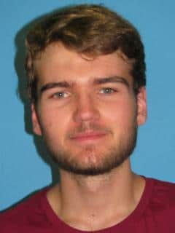
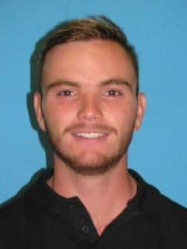
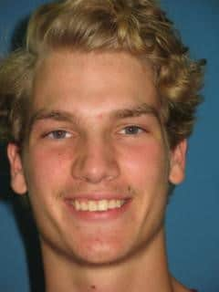
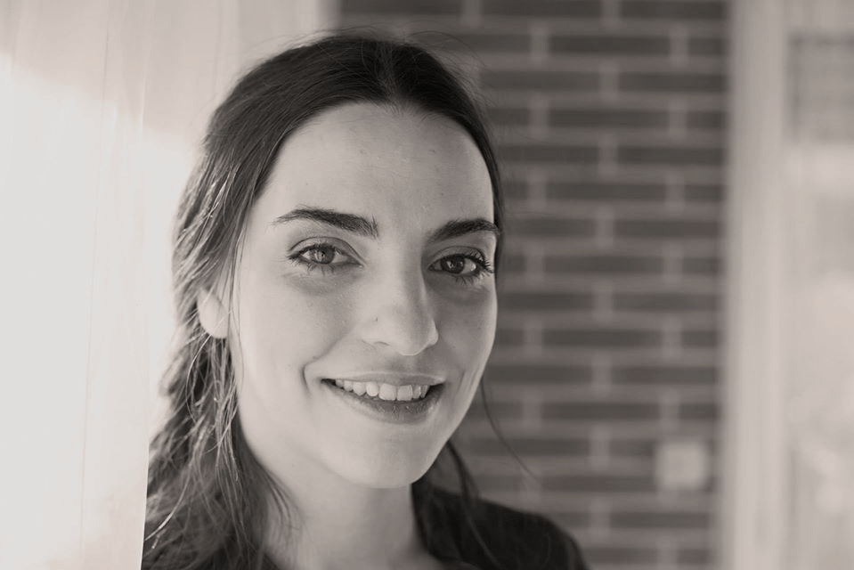
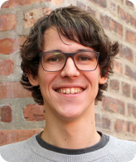
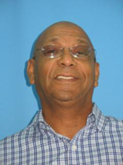
Tiaan Cilliers
(Engineering)
Ralph McDougall
(Engineering)
Bradley Jacobs
(Engineering)
Jacques Wust
(Engineering)
Dr Sophie Marques
(Mathematics)
Dr Herman Kamper
(Electrical & Electronic Engineering)
Prof Andrew Fransman
(Mathematics)

Slide 5
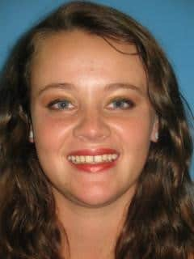
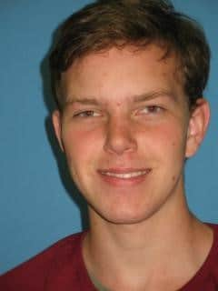
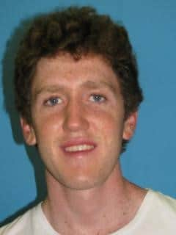
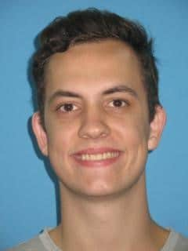
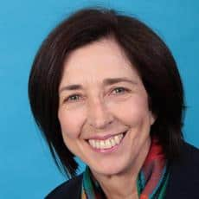
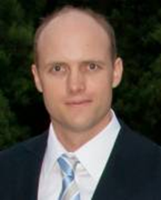
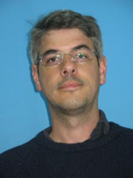
Suné van Dyk
(Education)
Brendan Watling
(Science)
Jean Durand
(Science)
Wicus van der Linden
(Science)
Dr Erna Lampen
(Curriculum Studies)
Dr James Gray
(Mathematics)
Prof Hugo Touchette
(Applied Mathematics)

Slide 6
Excerpts from Letters: Lecturers to Students
"Thank you for allowing me to teach you. It was a privilege and an honour."
"Never lose yourself along the way and do keep your genuine balance of self-confidence and humility."
"You are an example of an individual that aims to build a culture that promotes success: not only [to] have pleasant social experiences but being active role-players within and beyond South African borders."

Slide 7
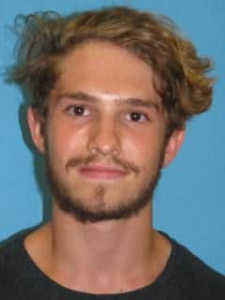
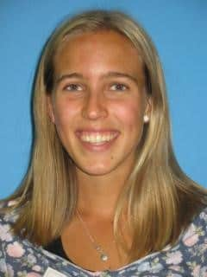
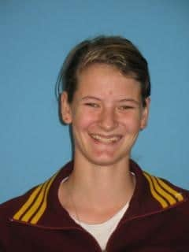
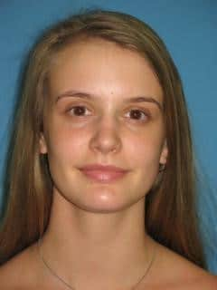
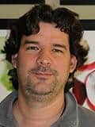
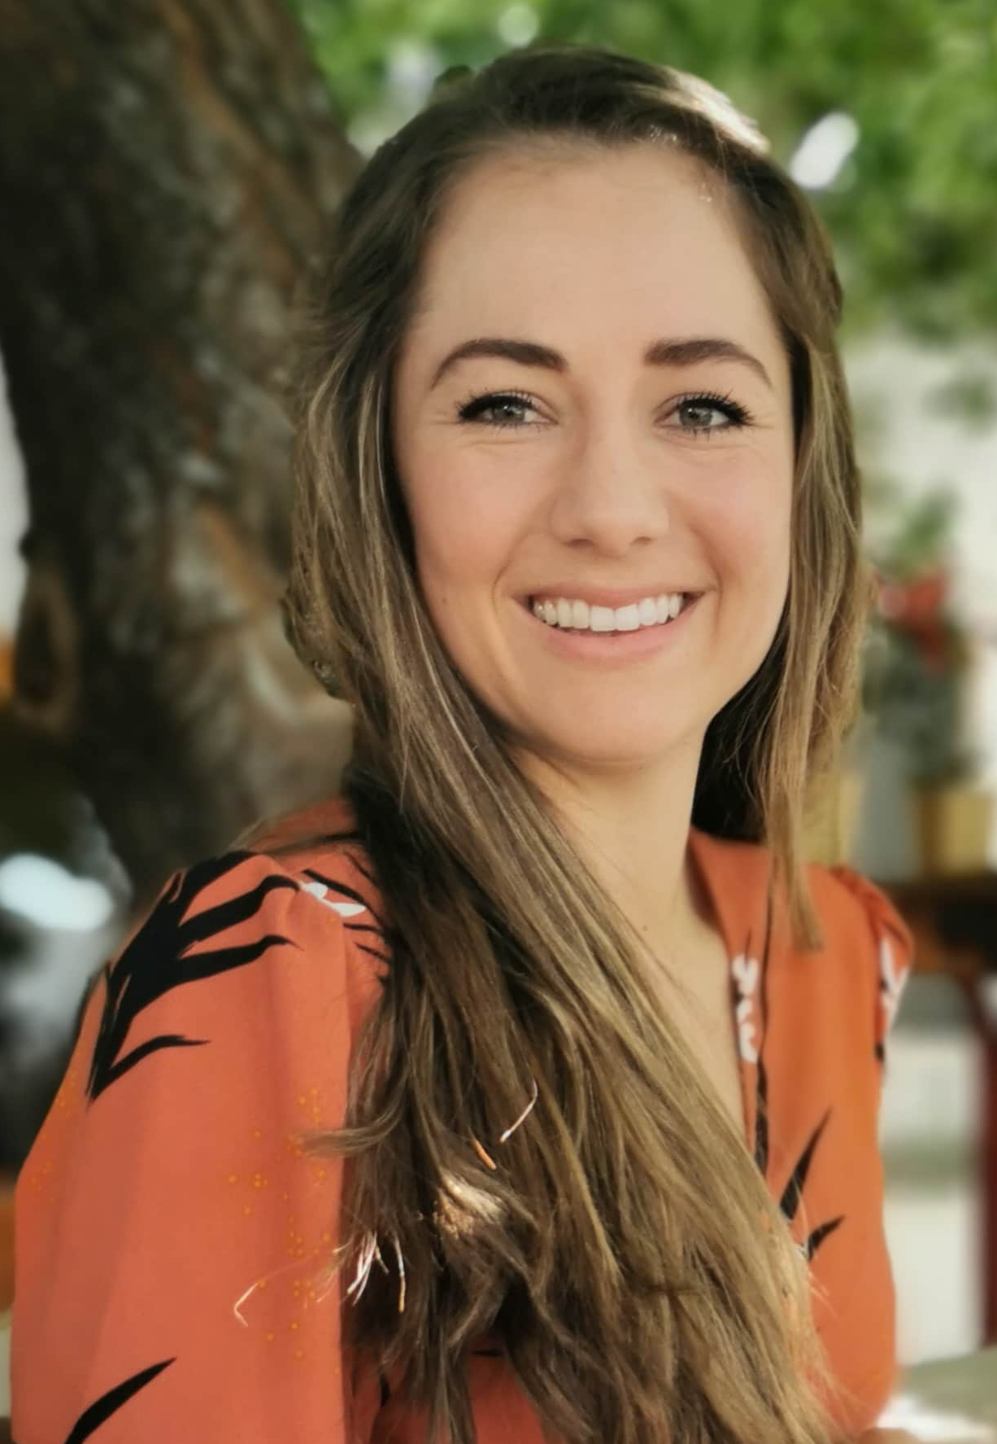
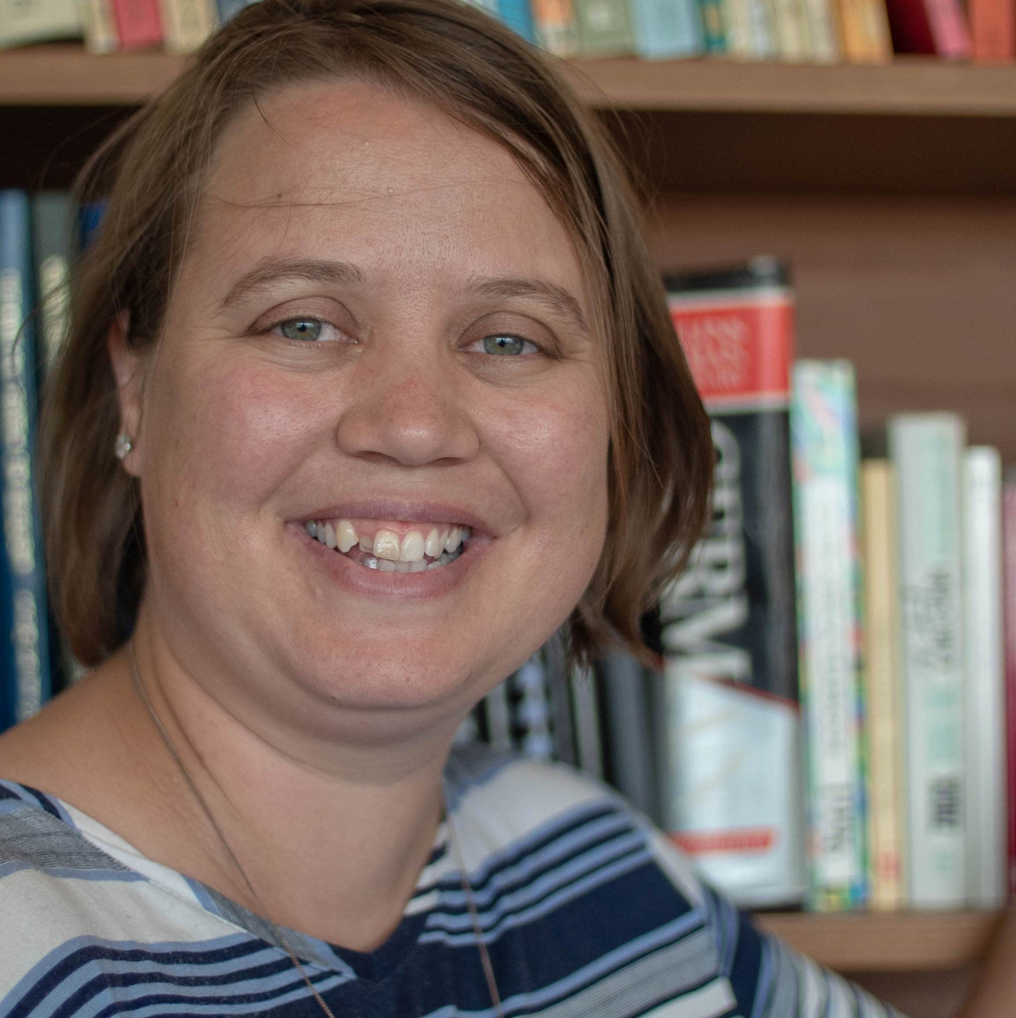
Jason Brown
(Science)
Helette du Plessis
(AgriSciences)
Karli du Toit
(AgriSciences)
Julia Snyckers
(Arts & Social Sciences)
Prof Hugo Touchette
(Applied Mathematics)
Dr Michael Schmeisser
(Horticultural Science)
Ms Eva Nel
(AgriSciences)
Dr Doret Jordaan
(Modern Foreign Languages)

Slide 8
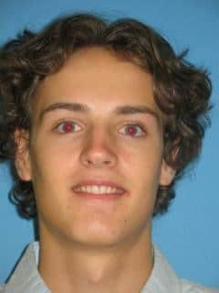
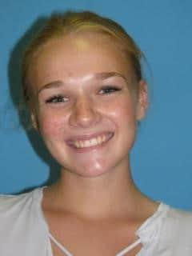
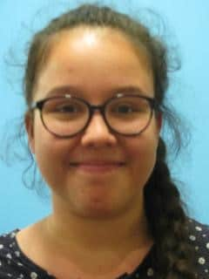
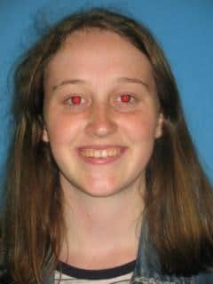
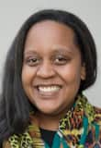
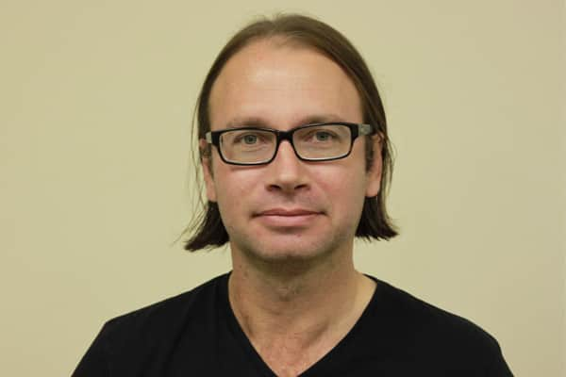
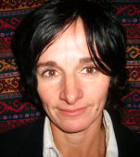
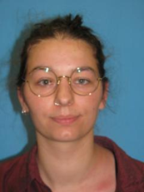
Pieter Conradie
(Arts & Social Sciences)
Lizè Myburgh
(Arts & Social Sciences)
Jessica Hillier
(Arts & Social Sciences)
Zoë McCathie
(Arts & Social Sciences)
Ms Amy Daniels
(Ancient Studies)
Prof JP Smit
(Philosophy)
Dr Marie-Anne Staebler
(Modern Foreign Languages)
Ms Léa Benabdelghaffar
(Modern Foreign Languages)

Slide 9
Excerpts from Letters: Lecturers to Students
"Keep going and enjoy every second of the journey!"
"I believe that you will advance to greater heights in your journey ahead."
"This is what lecturing is about – it’s about a learning experience for both students and a lecturer."
"Teaching is my greatest passion in life and it is a pleasure to be part of your success story."

Slide 10
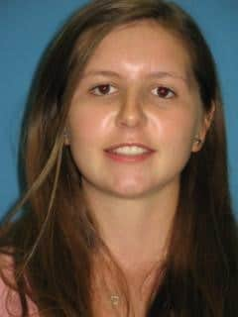
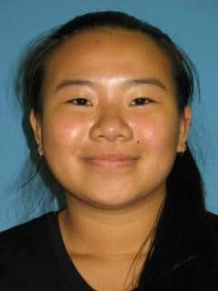
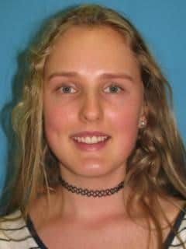
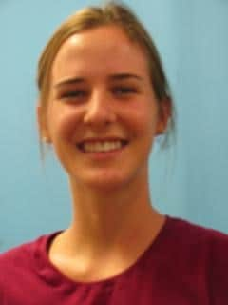

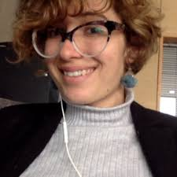
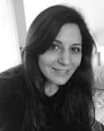
Tara Grobbelaar
(EMS)
Peng-chen Liang
(EMS)
Christa-Mari de Lange
(EMS)
Petronè Moolman
(EMS)
Dr Debra Shepherd
(Economics)
Dr James Gray
(Mathematics)
Ms Anieka Malan
(Economics)
Dr Karin-Therese Howell
(Mathematics)

Slide 11
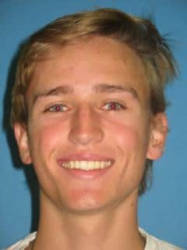
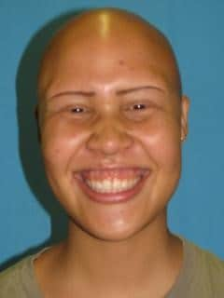
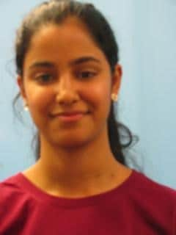
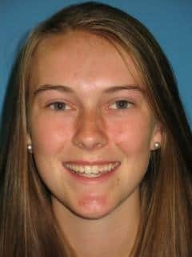
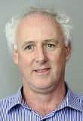
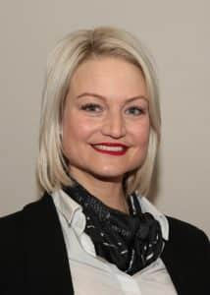
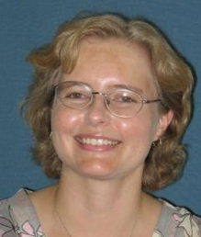
Matthew Wille
(EMS)
Nur-Ayn Mohamed
(EMS/Law)
Megan van Schalkwyk
(EMS)
Danielle-Verné Louw
(EMS)
Prof Garret Slattery
(Statistics & Actuarial Science)
Dr Doret Jordaan
(Modern Foreign Languages)
Dr Debbie Horsten
(Private Law)
Ms Sybil Smit
(School of Accountancy)

Slide 12
Excerpts from Letters: Students to Lecturers
"Words cannot begin to express the impact you have made not only in my academic career, but also in my life."
"Thank you for creating an environment of enthusiasm for learning and ALWAYS reassuring us to remain positive with your quick 'pep' talks."
"Most importantly, you were able to identify and relate with everyone in the class and use our state of mind as a foundation on which to teach us in the best way possible."
"I hope to carry forward the lessons I learnt during your lectures and one day exude the same passion for my career as you have for yours."

Slide 13
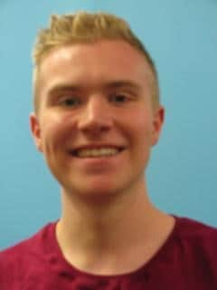
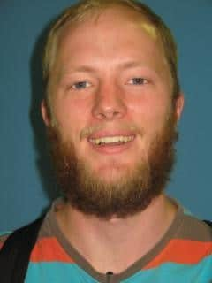
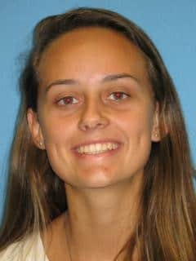
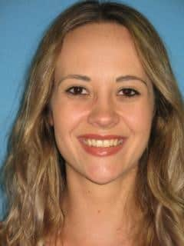
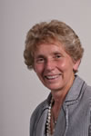
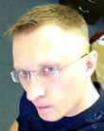
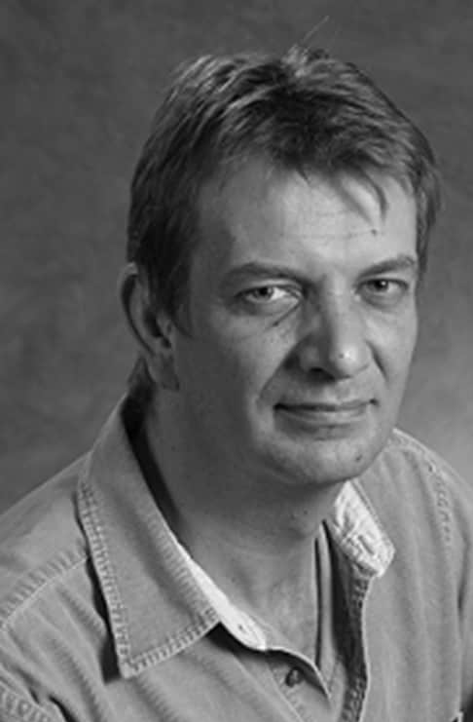
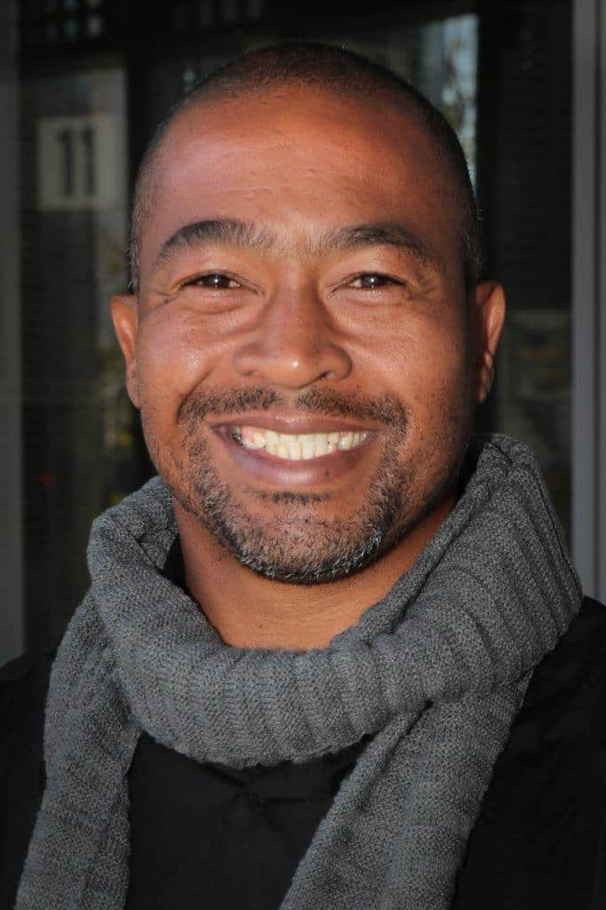
Slade van Rooyen
(Law)
Tanitah Deyzel
(Health Sciences)
Hans-Christoph Lange
(Theology)
Laura Badenhorst
(Health Sciences)
Prof Sonia Human
(Private Law)
Dr Alex Andrason
(Ancient Studies)
Prof Hans Strijdom
(Medical Physiology)
Mr Jerome Fredericks
(Occupational Therapy)

Slide 14








Suewellyn Zimmerman
(Health Sciences)
Karabo Bapela
(Arts & Social Sciences)
Thando Mtimkulu
(Engineering)
Rehab Kgomotso Botlholo
(Military Sciences)
Ms Helen Heath
(Speech-Language & Hearing Therapy)
Mr JC Rademeyer
Dr Jacques Masuret
(Mathematics)
Ms Modiehi Theletsane
(Mathematics Mil)

Slide 15
"… there is no University without the staff, from Rector, Professor, Lecturer to cleaning staff and everyone in between."
(A top first-year student, 2019)

