Slide 1

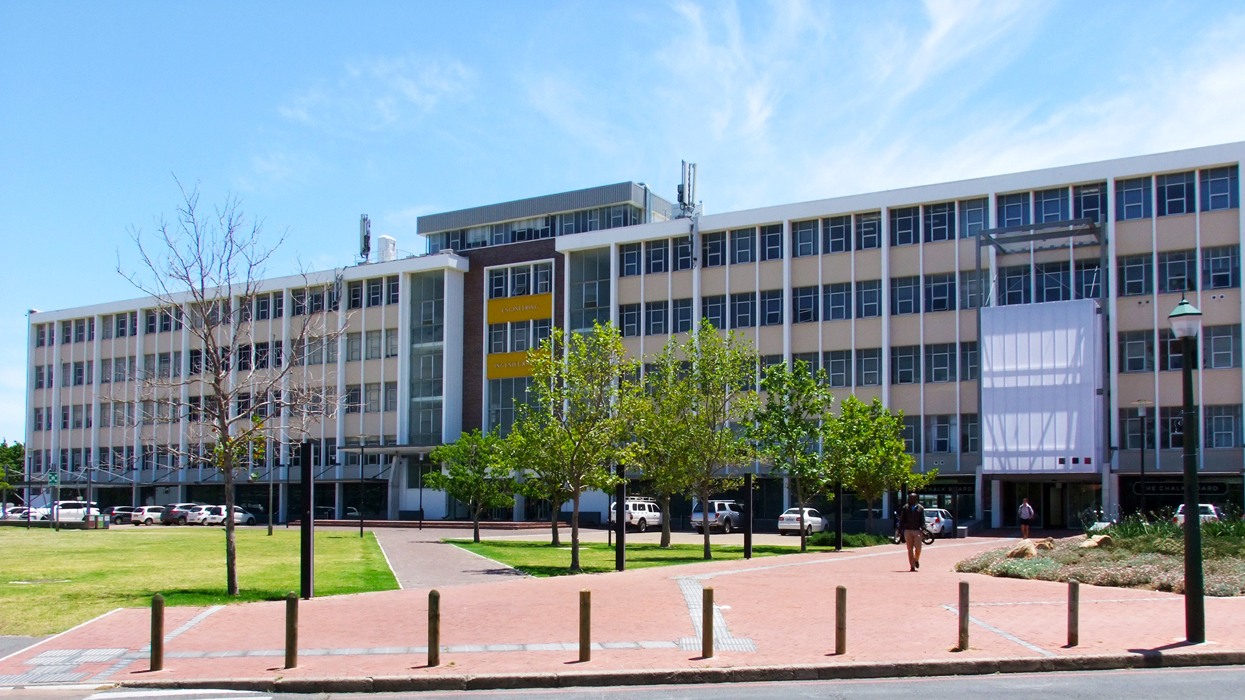
Department of
Industrial Engineering
Safety Training 2024
Photo by Stefan Els

Slide 2
Campus Security contact number : 021 808 2333
FIRE/EXPLOSION/BOMB SCARE
Call Campus Security
Help/stay with injured, otherwise evacuate
Do NOT try to extinguish fire if it endangers your health or life
POWER CUTS
Prepare for when power comes on again
Always consider all connections to be live
GOOD IDEA Save
Campus Security
number on your
cell phone
021 808 2333
Staff and Senior Students of the Industrial Engineering Building

Slide 3

EVACUATION PROCEDURES
Assembly Point Ent. 6
Banghoek Avenue
When siren sounds or instructed by safety officer
  Leave building immediately through nearest exit
Immediately obey safety officers during exercises
Last person leaving a room: close door and hang out orange flyer on doorknob
Do not use the elevator

Slide 4
PERMISSIONS REQUIRED
No person may use dangerous equipment alone
E.g., equipment with exposed moving parts, the potential for explosions/fire/electrical shock, high pressure/velocity gas/air
There must be at leat one other person in the same lab, also after hours
No unauthorized persons may work on electrical equipment
The law is very strict in this regard
A student is NOT allowed to fit a 15A plug
Students must obtain permission before they work in any laboratory or work with any equipment
Obtain permission from the person in charge of that equipment or lab (given on the door of labs/otherwise ask lecturer or lab manager)
Staff and Senior Students of the Industrial Engineering Building

Slide 5
REPORTING OF INCIDENTS
Report all safety risks to the technician/lecturer/chairperson or Campus Sec. at all hours
E.g., unsafe/faulty electrical wiring or cables, compressed air pipes/hoses, etc.
Report all incidents in which a person is injured immediately to the technician/lecturer/chairperson or Campus Sec
Legally required reporting procedures apply
Any injury that may possibly require medical treatment or have long term effect
*If fatal (or potentially fatal) injuries occur – law specifies that you must not disturb the site
Staff and Senior Students of the Industrial Engineering Building

Slide 6
GENERAL SAFETY RULES
Applies to all students, staff and other persons present
In the IE Building
In the labs (situated in M&M Building)
OVERRIDING PRINCIPLE:
Prevent risks to people and equipment by
Being sensible,
Careful and
Pro-active
Remember the main rule of thumb is to use common sense and not take any chances
Staff and Senior Students of the Industrial Engineering Building

Slide 7
General Safety Rules (continuing)
According to Occupational Health and Safety Administration - students are viewed as employees
The law makes no provision for something like “at own risk/responsibility”
IMPORTANT:
All students/visitors must obey instructions of lecturer/technician or other staff members regarding safety - (not allowed to refuse according to law).
Staff and Senior Students of the Industrial Engineering Building

Slide 8
Genera Safety Rules (continuing)
GENERALLY APPLICABLE
No smoking allowed anywhere in the building, or within 20 m of an entrance
  Windows are also considered to be entrances
When you leave the office every evening
  Turn off lights, printers, monitors, air-cons
  Close all taps and fire doors
Back-up electronic data regularly; keep off-site back-up copy
  Departmental backup server is an option
Lock office and lab doors when you leave
Report suspicious people to Campus Security (021 808 2333)
Staff and Senior Students of the Industrial Engineering Building

Slide 9
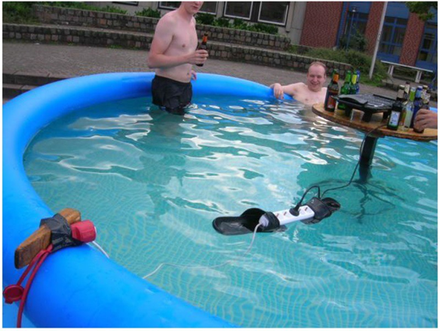
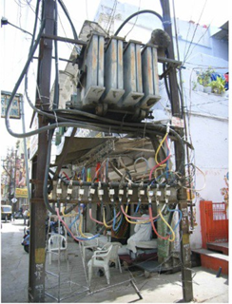
Examples of What NOT to DO
Staff and Senior Students of the Industrial Engineering Building

Slide 10
RULES WHEN HANDLING HAZARDOUS MATERIALS
Following must be disposed of in approved ways
Computer equipment
(contact Dean Johnson deanj@sun.ac.za)
Batteries
(contact Amelia Henning ah2@sun.ac.za)
Chemicals
(contact Xola Madyibi xola@sun.ac.za )
Handling Hazardous materials
Staff and Senior Students of the Industrial Engineering Building

Slide 11
CLOTHES AND SAFETY EQUIPMENT
CLOTHES AND SAFETY EQUIPMENT
No bare feet allowed in the building
Only closed shoes allowed in the lab area- NO flip-flops
Safety shoes (hard toe) compulsory when moving heavy objects
PPE (e.g., hearing protection, safety goggles) compulsory where signposted
No loose clothes or long hair near moving machines
Make sure you know where the nearest fire extinguisher or hose is before you start working in the lab
Staff and Senior Students of the Industrial Engineering Building

Slide 12

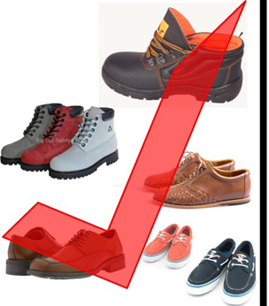
Allowable Shoes in Lab Areas
YES
Staff and Senior Students of the Industrial Engineering Building

Slide 13
RULES IN LABORATORY AREAS
No unauthorized persons may enter a lab or workshop
Keep doors closed, even during office hours
Only access demarcated areas in the workshop
No-one may work alone in a lab (excluding offices in labs)
Also applies to after hours
At least one other person must be within hearing distance
Laboratory Areas
Always have a cell phone with you
24/7
Emergency no.
021 808 2333
Staff and Senior Students of the Industrial Engineering Building

Slide 14
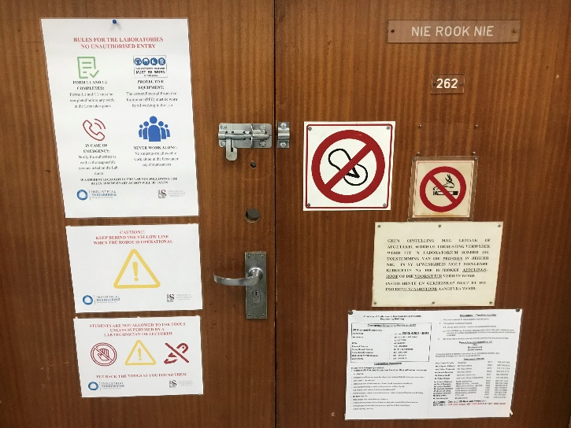
Laboatory Areas
Staff and Senior Students of the Industrial Engineering Building

Slide 15
LAB PRACTICALS
Whenever or wherever you attend a laboratory practical – remember
Each practical must start with going through safety instructions for that practical
Attendance register for each practical – need to be signed by anyone attending the practical to confirm that he/she understands the safety procedures
Laboratory Practicals
If prac does not start with a safety briefing, please demand that it does
Staff and Senior Students of the Industrial Engineering Building

Slide 16
LABORATORY SETUPS
No person may use dangerous equipment alone
E.g., equipment with exposed moving parts, the potential for explosions/fire/electrical shock, high pressure/velocity gas/air
There must be at leat one other person in the same lab, also after hours
No unauthorized persons may work on electrical equipment
The law is very strict in this regard
A student is NOT allowed to fit a 15A plug
Students must obtain permission before they work in any laboratory or work with any equipment
Obtain permission from the person in charge of that equipment or lab (given on the door of labs/otherwise ask lecturer or lab manager)
Staff and Senior Students of the Industrial Engineering Building

Slide 17
Laboratory setups (continuing)
If you build up a new lab setup or change an existing one
You must compile safety instructions before starting to operate the setup
Must obtain approval of instructions from supervisor/technician and lab manager before starting to operate the setup
Beware of preliminary testing in the workshop
If you use an existing lab setup
Obtain its safety instruction or compile a new set (to be approved by the supervisor/technician and lab manager)
Staff and Senior Students of the Industrial Engineering Building

Slide 18
Laboratory setups (continuing)
SAFETY PROCEDURES FOR LABORATORY SETUPS
Applies to all Industrial Engineering Projects, as well as all postgraduate students
Applies to each new/changed laboratory setup or where the procedure for an existing set-up is not available
Forms 1.1 and 1.2 can be downloaded from https://ie.sun.ac.za/health-and-safety/ and must be filled out and signed before starting any Lab Work
Staff and Senior Students of the Industrial Engineering Building

Slide 19
Safety procedures for Laboratory setups (continuing)
Step 1: Determine the potential risks the setup holds
The health and safety of the people who are going to use the setup
The health and safety of the people who are in close proximity to the setup
The equipment itself, the environment, surrounding
buildings, etc
Examples of risks that must be considered
Uncontrolled accumulation of flammable gases
Inadequate protection from fast rotating masses, such as shafts and fans
Inadequate insulation of electrical equipment, especially
when working with water
Staff and Senior Students of the Industrial Engineering Building

Slide 20
Safety procedures for Laboratory setups (continuing)
Step 2: Determine the steps that can be reasonably accomplished to minimize the risk
Seriousness and scope of the risk
Availability of knowledge regarding the risk, and methods to minimize/remove the risk
Availability and appropriateness of methods to minimize/remove the risk
The costs involved to minimize/remove the risk with respect
to the associated advantages
The project must be stopped if funding is not available to minimize/remove significant risks
Staff and Senior Students of the Industrial Engineering Building

Slide 21
Safety procedures for Laboratory setups (continuing)
Step 3: Design the laboratory setup with mitigating/minimizing the risks in mind
Examples of measures that can be taken
Protective screens on rotating machinery
Adequate ventilation to avoid accumulation of gases
Adequate insulation of electrical equipment, as well as an emergency stop
Interlocks to prevent access to moving parts
Screens over belts and chains
Staff and Senior Students of the Industrial Engineering Building

Slide 22
Safety procedures for Laboratory setups (continuing)
Step 4: Compile safety and operating instructions with the above-mentioned in mind
Use personal protective equipment
Maintaining good housekeeping at all times
Purging procedures when using flammable gasses/fuels
Step 5: Compile housekeeping instructions with the above-mentioned in mind
Staff and Senior Students of the Industrial Engineering Building

Slide 23
Safety procedures for Laboratory setups (continuing)
Step 6a: Present the design, safety instructions and housekeeping instructions to your project supervisor
The supervisor must approve the design and safety procedures by signing your document
Step 6b: Obtain approval from the technician responsible for the laboratory
Signature required
Step 6c: Original signed document handed over to the laboratory manager
Step 6d: Copy of the signed document must be displayed next to the laboratory setup
Staff and Senior Students of the Industrial Engineering Building

Slide 24
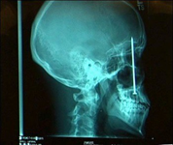
Safety procedures for Laboratory setups (consinuing)
Laboratory work is not allowed unless these steps have been completed
Be wise
Do NOT take risks
Be pro-active
VERY
IMPORTANT
Staff and Senior Students of the Industrial Engineering Building

Slide 25

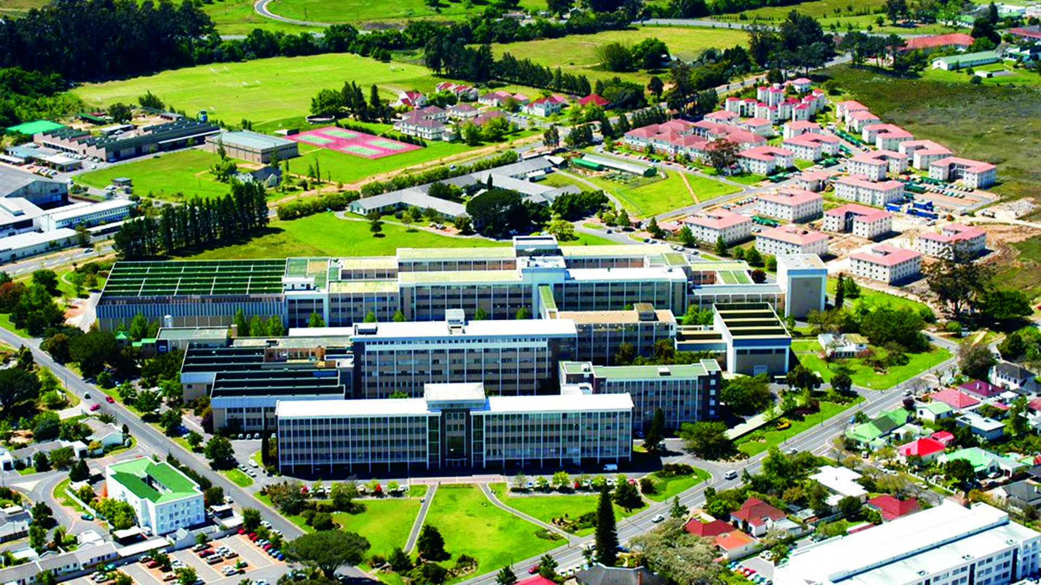
Thank you
Enkosi
Dankie
Photo by Stefan Els

