Slide 1

Emergency migration to online teaching in the Covid-19 pandemic: impact on the mental health and wellness of lecturers
Salisha Maharaj
Clinical Psychologist
Lecturer
Stellenbosch University

Slide 2
Objectives
Covid-19 and Emergency Migration to Online Teaching
Mental Health and Covid-19
Reframing, resources and support

Slide 3
Covid-19 and Emergency Migration to Online Teaching
Emergency migration
Making rapid changes
The Stellenbosch Response

Slide 4
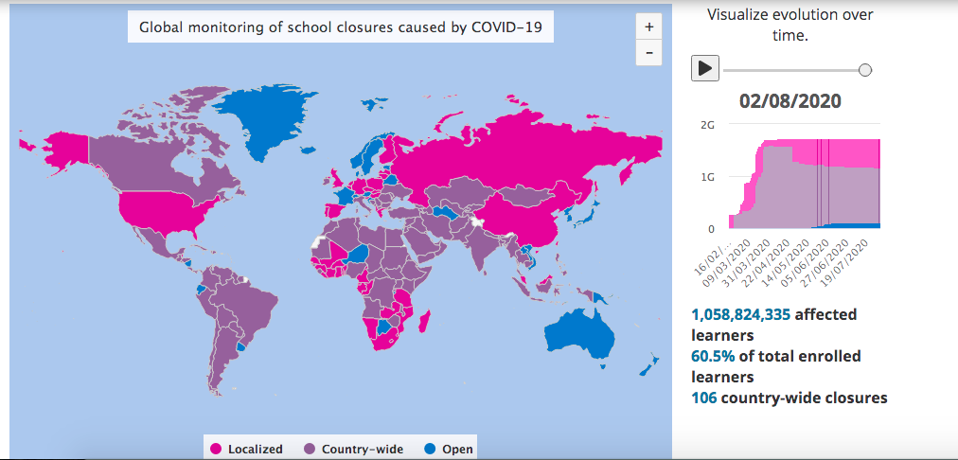
Covid-19 and emergency migration to online teaching
The sudden announcement of lockdown on 26 March 2020 to curb the spread of the Coronavirus pandemic saw the immediate closure of all non-essential services and these included schools and all tertiary institutions.
This image represents the global school closures sourced from UNESCO, showing that over a billion students worldwide have been impacted with only a handful of countries having reopened face to face teaching
Notes:
The sudden announcement of lockdown on 26 March 2020 to curb the spread of the Coronavirus pandemic saw the immediate closure of all non-essential services and these included schools and all tertiary institutions. This image represents the global school closures sourced from UNESCO, showing that over a billion students worldwide have been impacted with only a handful of countries having reopened face to face teaching

Slide 5
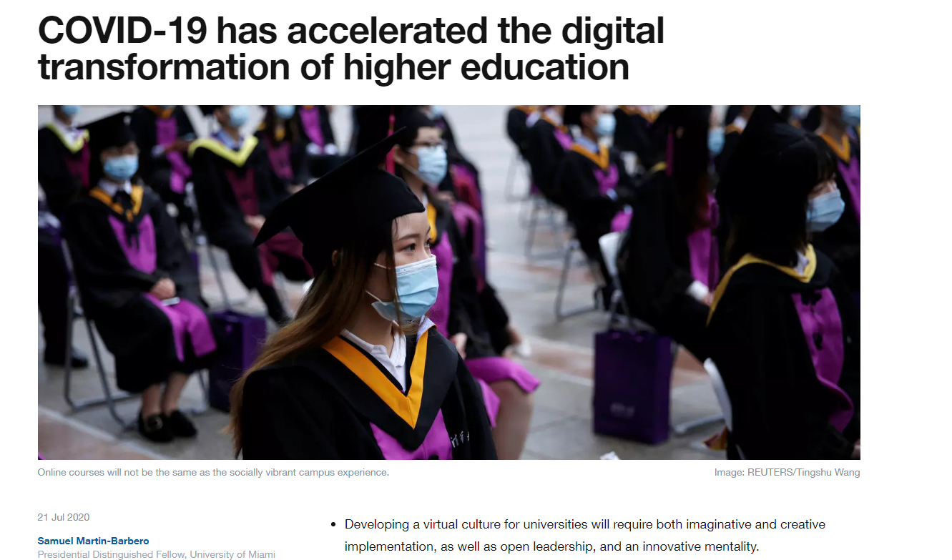
Notes:
Universities and schools worldwide had to rapidly move to online teaching in order to save the academic year, and 2020 sees the largest migration to learning and working online in the 21st century.

Slide 6
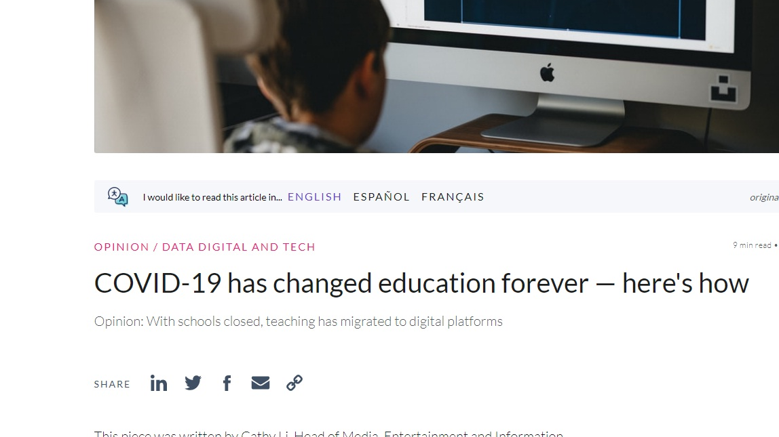

Slide 7
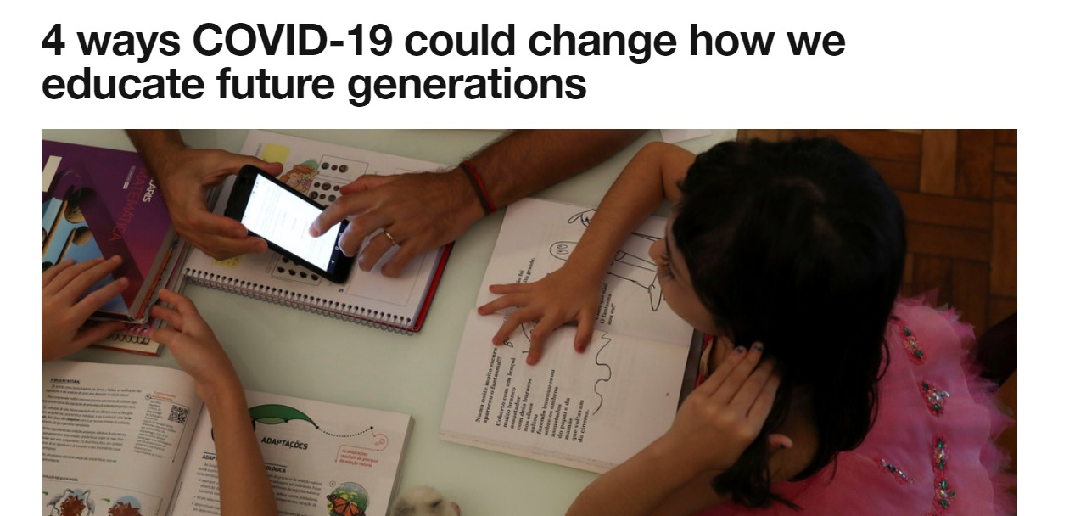
1. Educating citizens in an interconnected world 2. Redefining the role of the educator
3. Teaching life skills needed for the future 4. Unlocking technology to deliver education
Notes:
1. Educating citizens in an interconnected world
COVID-19 is a pandemic that illustrates how globally interconnected we are – there is no longer such a thing as isolated issues and actions. Successful people in the coming decades need to be able to understand this interrelatedness and navigate across boundaries to leverage their differences and work in a globally collaborative way.
2. Redefining the role of the educator
The notion of an educator as the knowledge-holder who imparts wisdom to their pupils is no longer fit for the purpose of a 21st-century education. With students being able to gain access to knowledge, and even learn a technical skill, through a few clicks on their phones, tablets and computers, we will need to redefine the role of the educator in the classroom and lecture theatre. This may mean that the role of educators will need to move towards facilitating young people’s development as contributing members of society.
3. Teaching life skills needed for the future
In this ever-changing global environment, young people require resilience and adaptability – skills that are proving to be essential to navigate effectively through this pandemic. Looking into the future, some of the most important skills that employers will be looking for will be creativity, communication and collaboration, alongside empathy and emotional intelligence; and being able to work across demographic lines of differences to harness the power of the collective through effective teamwork.
4. Unlocking technology to deliver education
The COVID-19 pandemic has resulted in educational institutions across the world being compelled to suddenly harness and utilize the suite of available technological tools to create content for remote learning for students in all sectors. Educators across the world are experiencing new possibilities to do things differently and with greater flexibility resulting in potential benefits in accessibility to education for students across the world. These are new modes of instruction that have previously been largely untapped particularly in the kindergarten to Grade 12 arena.

Slide 8
Stellenbosch responds
SU has a long history of using technology in learning and teaching which it could build on.
It had furthermore, prior to the lockdown announcement, taken proactive measures to prepare for the very real possibility of a sustained period of temporary, fully online teaching and learning.
On 19 March, two days after it was announced that lectures would be suspended, an interactive website was launched on SUNLearn, offering step-by-step guidelines on all the essential online tools and relevant approaches that could enable academic staff to set up efficient online communication channels with students, and to design pedagogically sound online learning activities. The next day, a (still ongoing) series of daily online webinars was launched, focusing on preparing all lecturers for online teaching.
Although many lecturers have already explored blended teaching strategies in the past, fully online learning and teaching is unfamiliar territory for most of our staff.
Professor Arnold Schoonwinkel, vice-rector: learning and teaching (deputy vice-chancellor); Dr Antoinette van der Merwe, senior director: Division for Learning and Teaching Enhancement; and Miné de Klerk, advisor for online and hybrid learning at Stellenbosch University, South Africa.

Slide 9
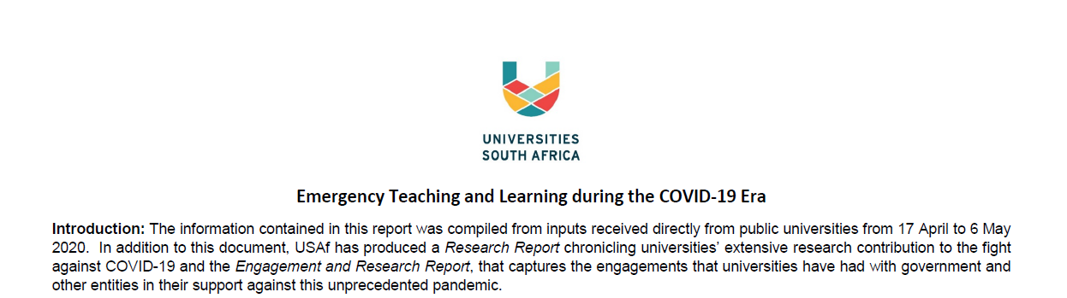
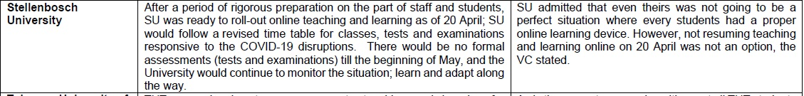
Stellenbosch responds
Notes:
This is a snapshot of SU’s plan at the beginning of lockdown. In comparison to other universities, SU was nearly immediately ready to move to online teaching. Other institutions sited struggling with technical support, limited resources for students such as devices and data and difficulties with migrating the teaching curriculum online.

Slide 10
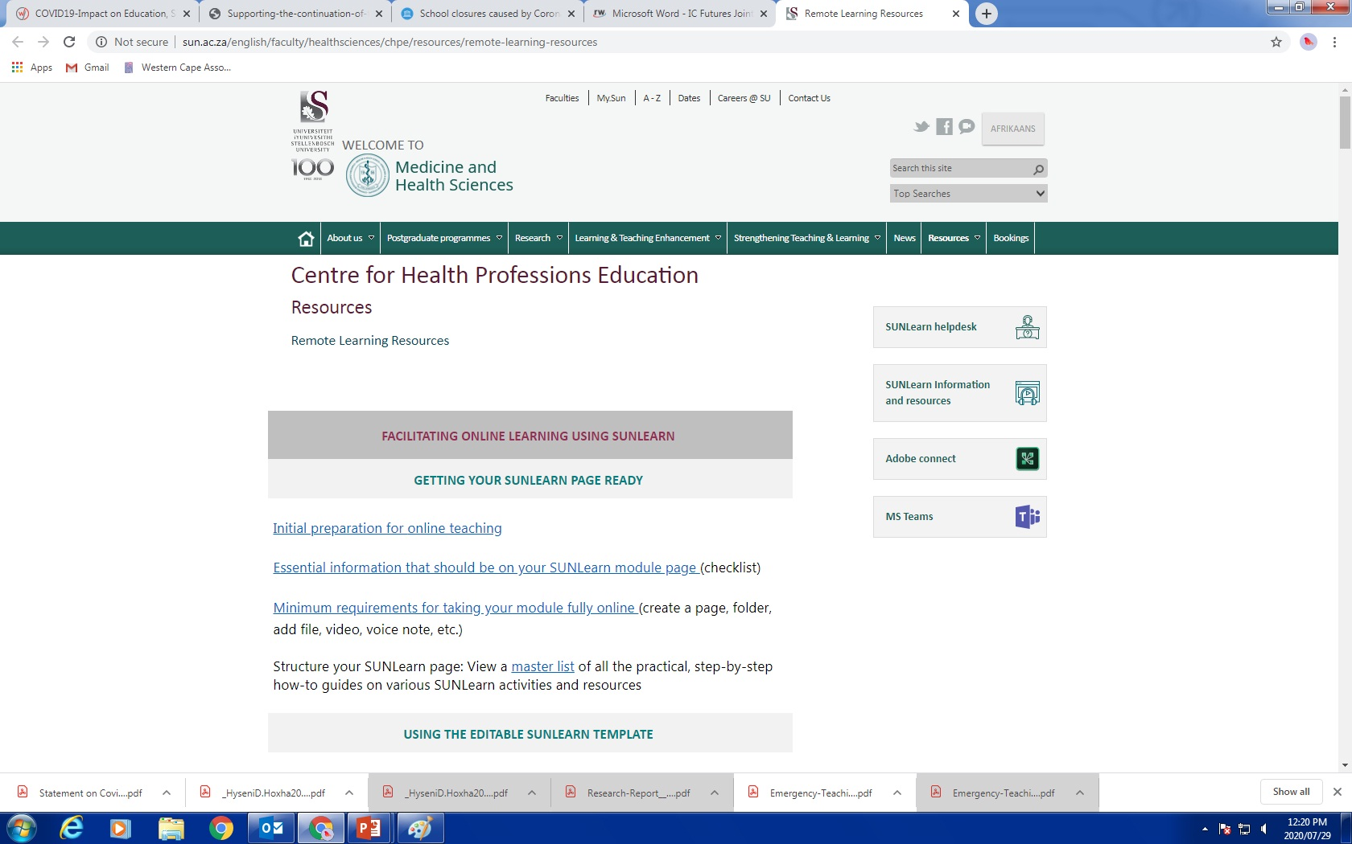

Slide 11
Mental Health and Covid-19
Stress-response to past pandemics
Unique stress of Covid-19
Mental health of lecturers

Slide 12
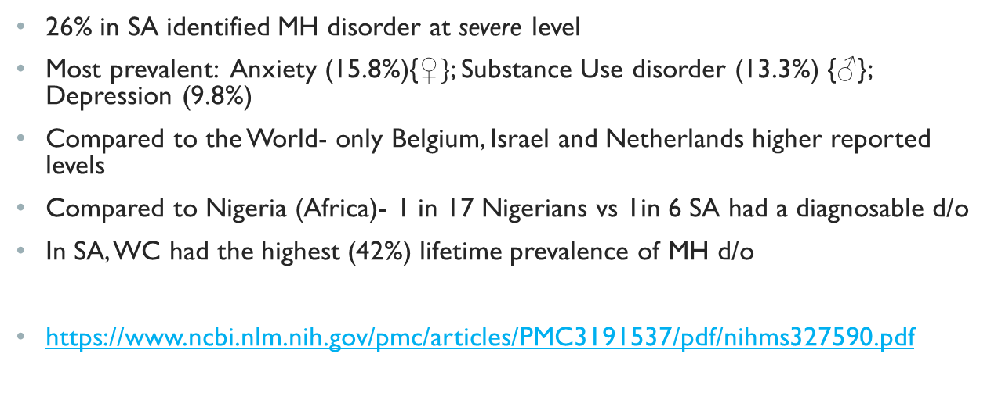
South-African Stress and Health study (SASH) (2012)
26% in SA identified MH disorder at severe level
Most prevalent: Anxiety (15.8%){$♀\}$; Substance Use disorder (13.3%) {$♂$}; Depression (9.8%)
Compared to the World- only Belgium, Israel and Netherlands higher reported levels
Compared to Nigeria (Africa)- 1 in 17 Nigerians vs 1in 6 SA had a diagnosable d/o
In SA, WC had the highest (42%) lifetime prevalence of MH d/o
https://www.ncbi.nlm.nih.gov/pmc/articles/PMC3191537/pdf/nihms327590.pdf
Notes:
world comparison is only where similar research were done
Nigeria was the only African country included in the research

Slide 13
Stress response to past pandemics
Brooks et al. (2020) shown the psychological impact of quarantine, based on 3166 papers reviewed, showed adverse psychological effects, including post-traumatic stress symptoms, confusion, and anger.
The Brooks team has demonstrated that the stress factors came from longer quarantine duration, infection fears, frustration, boredom, inadequate supplies, inadequate information, financial loss, and stigma during the pandemics.
The studies included epidemics as SARS, Ebola, H1N1 influenza, Middle East respiratory syndrome (MERS), and equine influenza.

Slide 14
The unique stress of covid-19
Stress as an inherent part of life
Stress that threatens homeostasis
Despite the absence of common definition and conceptualization of stress, that has changed over time; there is consensus that stress is an inherent part of life that is associated with several individually vital physiological, psychological and behavioural symptoms,
Monroe and Slavich (2016), Schuler (1980)
Stress can be defined as a state of disharmony and is neutralized by a complicated variety of physiologic and behavioural responses that aim to maintain/re-establish the threatened homeostasis (adaptive stress response).
Based on this definition, stress arises when a person perceives the demands of environmental stimuli to be higher than their ability to meet, mitigate, or alter those demands
Perturbing (1992), Lazarus and Folkman (1984)

Slide 15
Mental health of lecturers working online
Research into online lecturers’ health and wellbeing is not yet well established.
Few reports exist regarding lecturers’ emotions concerning intense periods of working online
Emotions most commonly found are negative such as anxiety and stress
The review suggests there are a number of negative health outcomes including: physical; social; spiritual; mental; emotional; and cognitive
Health and wellbeing of the online lecturer: a phenomenological study. Frances Ann Whittet (Jan, 2020)

Slide 16
Mental health of lecturers working online
Lecturers teaching online are at higher risk for burnout
There is no clear divide between “at work” and at home
The lack of face-to-face contact also increases the amount of electronic contact time a lecturer has with the students
Lecturers therefore report being inundated by emails, answering questions and responding to demands of students individually rather than in group/classroom settings
A study by Bennett’s (2014) suggested that lecturers teaching online felt unprepared and inadequate for the added burdens of the online environment
Bennett, L. 2014. “Putting in More: Emotional Work in Adopting Online Tools in Teaching and Learning Practices.” Teaching in Higher Education 19 (8): 919–930.

Slide 17
Reframing, resources and support
Pandemic Stress Compensator Framework as a way of thinking about the pandemic and stress
Promoting health and well-being of the online lecturer: tips and tricks
The Crisis Toolkit: Developing a sense of control
SU Support and EAP

Slide 18
Pandemic Stress Compensator Framework
The framework targets to raise the capacity of the COVID-19 individuals and support the communities for managing stress, through two levels. The first level (line 1) focuses on what can be achieved, while the second level (line 2) focuses on the psychological support strategy
Minimising Stress Exposure During Pandemics Similar to COVID-19 Mohamed Buheji, Haitham Jahrami, Ali Sabah Dhahi

Slide 19
Pandemic Stress Compensator Framework

Slide 20
Pandemic Stress Compensator Framework
The first level (line 1) in the framework is set to focus on what can be achieved. Here the tools would depend on the best practices of reducing stress through seeking new opportunities during- and after-pandemic, besides visualising what could be the best outcome of this crisis.
This should help people to move from ‘living with the uncertainty’ to the building of ‘capacity of coping with uncertainties’

Slide 21
Pandemic Stress Compensator Framework
The second level (line 2), focuses on compensating the stress on the mind-set through the ‘psychological support strategy’ which helps to manage or eliminate negative exposures and to support the first level.
Here people would need to build their ‘social capital’ and target towards having or working on something, life goal, that would give them a sense of achievement.
Such type of support would lead to better ‘psychological resilience’, hopefully with a personality that visualises a better world after the pandemic.

Slide 22
Loss and hope
Many people have been deeply impacted by Covid-19 and the lockdown
We should not minimize the real sense of fear, despair and anxiety that many of us carry
Many past losses have been reignited for people facing lockdown
The challenges of managing working from home and parenting without external support has been enormous
For many there is hope in new beginnings, new endeavours, and new skills discovered during this time but the impact of 2020 on our mental health and well-being cannot be side-lined

Slide 23
Promoting health and well-being of the online lecturer
Reflection can be a useful tool for anxiety relief
Where this is systematic, conscious, and discussed within the shared professional dialogue, lecturers may more easily learn the art of online pedagogy
Lecturers are leaders, but also learners and they themselves need feedback/feedforward as there can be areas of significant mismatch between what learners and lecturers perceive is of value
Perhaps not all lecturers are suited to the online pedagogical environment. There may be a sense of solitude, of not connecting, and of merely ‘performing’ with no perception of really ‘sharing that space’ with learners
Such experiences may demonstrate the importance of reaching self-awareness through self-evaluation and appraisal, bringing a more positive outlook on health and wellbeing through an ease of tensions
Health and wellbeing of the online lecturer: a phenomenological study, Frances Ann Whittet (Jan,2020)

Slide 24
Health-promoting advice
Get plenty fresh air
Drink plenty water
Move regularly and ensure breaks
Try to be realistic and set out a plan for breaks, and stick to it
Prepare healthy meals in advance of heavy marking periods
Request workspace assessment
If at all possible, restrict the online work
Health and wellbeing of the online lecturer: a phenomenological study, Frances Ann Whittet (Jan,2020)

Slide 25
Health-promoting advice
Be very organised
Keep on track
Consider deadlines carefully
Ensure enough time between assessments to give feedback/feedforward
Avoid going overboard with feedback/feedforward
Listen to the guidance from the External Examiner
Flag-up all challenges to management; at every opportunity
Have clear boundaries for learners so they know what to expect
Don’t do any ‘proper’ work over weekends
Health and wellbeing of the online lecturer: a phenomenological study, Frances Ann Whittet (Jan,2020)

Slide 26
Developing a sense of control
The key to develop a “healthy” level of personal control seems to be by gaining accurate understanding of one’s possibilities and limits of control.
This accurate self-knowledge about personal control allows the individual to invest time and energy in actions that lie within the spheres of personal control and avoid wasting time on actions that cannot be controlled.
Page 14 of “The Crisis Kit”

Slide 27
Support
“The “new normal" has required massive behavioural change, and flexible adaptation to new ways of being and working. Employee Wellness recognizes that these are difficult and uncertain times, and we encourage staff to take care of themselves while juggling remote working, parenting, home schooling, and other demands on their time and energy”
http://www.sun.ac.za/english/human-resources/employee-wellness/eap

Slide 28
Support
Shibu Mamabolo - Head: Employee Wellness - shibu@sun.ac.za​
Dr David Fourie - SU external EAP Counsellor - dpfourie@telkomsa.net​
Dr. Debbie Marais – Volunteer ​Psychologist - debbiem@sun.ac.za​
Kevashini Govender- Naidoo and Ayesha Booley-Schreuder - Clinical Psychologists - info@Impiloconsulting.com​
SADAG 24 hour helpline - 0800 456 789 - www.sadag.org​
For more information on Covid – 19 visit - www.sacoronavirus.co.za

