Slide 1


Public Theology for the Public Good: A Blended Teaching and Learning Approach to Theological Education
A) Background
“As individuals and in congregations, we are in positions to practise this spirituality and to study our immediate contexts to discern where and how best to engage its deepest or most pressing needs. We look around us, and what do we see? Where is the human need that calls for our attention, engagement, and love? That is where the pilgrimage begins.”
http://www.oikoumene.org/en/resources/documents/wcc-programmes/an-invitation-to-the-pilgrimage-of-justice-and-peace
Notes:
Public Theology 312: The question of public morality is an important matter for church and public life. This module explores various ethical challenges in public life and the actual and potential role and impact of Christian faith for the common good. In short the module asks the question: How do we as theologians, ministers, church leaders and members contribute to our broader society.
Isabel Apawo Phiri from the World Council of Churches: due to the nature of our faculty we have connection with world-wide religious organisations who often come to discuss and present their projects. Dr Phiri, as representative of the World Council of Churches, came to introduce us to their own public theology project, namely The Pilgrimage of Justice and Peace- a public, spiritual (nature of pilgrimage) project launched in 2013 with the aim (see above)
This project could provide Public Theology 312 the opportunity integrate and contextualise the module content with an authentic learning experience, learning as they pilgrimage the essence of the question: How do we contribute?

Slide 2
Public Theology for the Public Good: A Blended Teaching and Learning Approach to Theological Education
B) Systematic Theology 312
Public Theology – About the course
Third year course that is compulsory for BTh and BDiv students
HEQF Level 7
8 Credits
Forms part of the Systematic Theology offering (i.e., the beliefs and ethics section of the course)

Slide 3
Public Theology for the Public Good: A Blended Teaching and Learning Approach to Theological Education
C) Systematic Theology 312
Public Theology – Outcomes
By the end of the course learners should be able to:
Account for the meaning, nature, methods and issues of public theology and its ethical role in public life.
Identify, recognize and critique relevant arguments of an ethical nature within the public domain and the various publics of society
Apply Christian theological resources and insights to various public morality challenges.

Slide 4
Public Theology for the Public Good: A Blended Teaching and Learning Approach to Theological Education
C) Systematic Theology 312
Public Theology – Outcomes
By the end of the course learners should be able to:
Provide thought leadership in church and public life towards responsible moral formation for a more humane public life.
Responsibly engage their faith within a variety of publics in society working for the common good.
Contribute constructively towards issues of public concern from the perspective of their theological convictions.

Slide 5
Public Theology for the Public Good: A Blended Teaching and Learning Approach to Theological Education
D) Systematic Theology 312
Public Theology – What is public theology?
Public Theology in a nutshell:
Not just the difference between ‘private’ and ’public’ faith. (Smit 2013:11-23)
Jürgen Habermas (Smit 2007)
Critical theory
Discourse ethics
Notes:
Smit, Dirk J. “The Paradigm of Public Theology - Origins and Development.” Edited by Heinrich Bedford-Strohm, Florian Höhne, and Tobias Reitmeier. Contextuality and Intercontextuality in Public Theology, Theology in the Public Square, 2013, 11–23.
Smit, D. J. “What Does ‘Public’ Mean? Questions with a View to Public Theology.” In Christian in Public Aims, Methodologies, and Issues in Public Theology, 1st ed., 11–47. SUN Press, 2007.
Tracy, David. “The Analogical Imagination: Christian Theology and the Culture of Pluralism.” Religious Studies Review 7, no. 4 (1981): 281–332.
Koopman, Nico. “Some Contours for Public Theology in South Africa.” International Journal of Practical Theology 14, no. 1 (2010): 123–138.

Slide 6
Public Theology for the Public Good: A Blended Teaching and Learning Approach to Theological Education
D) Systematic Theology 312
Public Theology – What is public theology?
David Tracy – The Analogical imagination (1981) (three publics)
Church
Theological academy
Society at large
Nico Koopman (2010) – three basic questions:
Public nature of God’s love (and will)
Public rationality of God’s love (and will)
The public meaning and nature of God’s love (and will)
‘bilingualism’
Notes:
Smit, Dirk J. “The Paradigm of Public Theology - Origins and Development.” Edited by Heinrich Bedford-Strohm, Florian Höhne, and Tobias Reitmeier. Contextuality and Intercontextuality in Public Theology, Theology in the Public Square, 2013, 11–23.
Smit, D. J. “What Does ‘Public’ Mean? Questions with a View to Public Theology.” In Christian in Public Aims, Methodologies, and Issues in Public Theology, 1st ed., 11–47. SUN Press, 2007.
Tracy, David. “The Analogical Imagination: Christian Theology and the Culture of Pluralism.” Religious Studies Review 7, no. 4 (1981): 281–332.
Koopman, Nico. “Some Contours for Public Theology in South Africa.” International Journal of Practical Theology 14, no. 1 (2010): 123–138.

Slide 7
Public Theology for the Public Good: A Blended Teaching and Learning Approach to Theological Education
E) Rationale behind the design
Learning objectives:
Experiencing the ‘inhabitants’ and ‘spaces’ of each public and their concerns
Identifying the sources that have currency for each public.
Touching base with the appropriate language that operates in each public.
Beginning to understanding the need for bilingualism between the publics.
Learning style:
Cognitive
Reflective
Integrated
Assessment:
Group participation
Personal reflection (DEAL)
Theoretical formulation
Integrated assessment
Notes:
The course is divided into three parts:
An introduction to core concepts and theories related to theology and the publics of society.
Engaging with different issues and concerns (ethical and moral dilemma’s) from the various publics.
Presenting examples of public theologies and public theologians and their work.
In order for learners to make the most of this course the first step is critical. If they don’t understand what public theology is, and why it matters, they may not be able to adequately engage for the rest of the course. Hence it is was important to design a learning experience that would expose them to the differences and complexities of the different publics of society, and then to expect them to engage their different learning faculties in order to complete the assessment for the course.

Slide 8
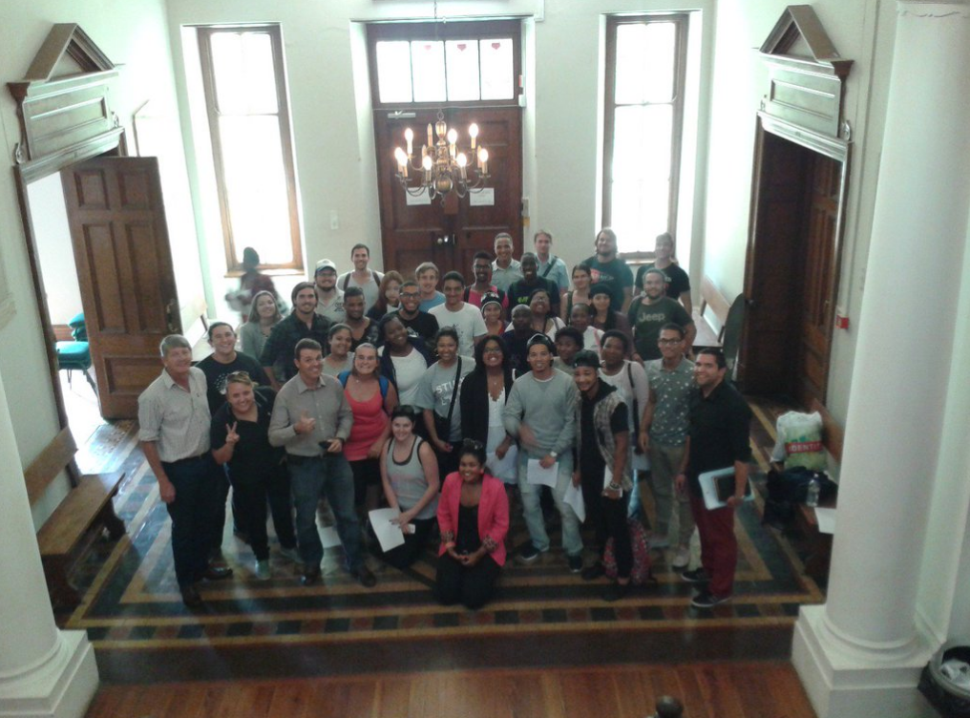
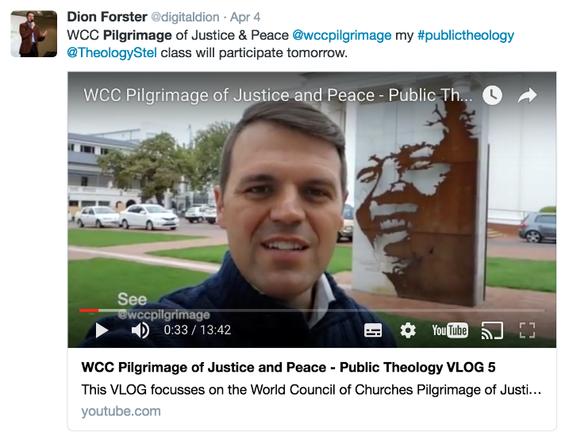
Public Theology for the Public Good: A Blended Teaching and Learning Approach to Theological Education
F) Resources and planning
Plan the route of the pilgrimage (related to World Council of Churches objectives and Course outcomes).
Invite participants from each ‘public’ to address the students.
Post written and video preparation for students to SUNlearn.
Design the DEAL reflection sheet and circulate in advance.
Prepare the assessment instructions and questions on SUNlearn

Slide 9
Public Theology for the Public Good: A Blended Teaching and Learning Approach to Theological Education
G) Authentic Learning
The pedagogical structure of this intervention is one of ‘Authentic Learning’- a term and structured concept coined by Herrington and Oliver in 2000 (Bozalek et al, 2013: 630)
Links to our own institutional graduate attributes :
An enquiring mind
An engaged citizen
A dynamic professional
A well-rounded individual
(see Jacobs & Strydom 2014 for a comprehensive discussion)
An attempt to create an environment for embedded and embodied theology.
Notes:
“They argued that the adoption of authentic learning as a pedagogical model can help to better prepare students for professional practice.” Refer listeners to article. This echoes much of what the university’s Graduate Attributes address: helping students and eventual graduates to acquire the necessary skills to translate, critically apply and therefore substantially use their theoretical knowledge in the ‘real world’, the world outside the academic and theoretical bubble.
This pilgrimage and the corresponding reflections and assessments was an attempt to assist students in embedding their theological, academic knowledge in a broader society- but also, through the act of the physical pilgrimage, help them find a way to embody this knowledge and carry it where they and others are.

Slide 10
Public Theology for the Public Good: A Blended Teaching and Learning Approach to Theological Education
G) Authentic Learning
Elements of authentic learning addressed:
“… elements are better viewed as continuums in evaluating how well they align with a particular course intervention.” (Bozalek et al, 2013: 636)
Access to experts at every point
Students had the opportunity to view elements from different perspectives and roles
Reflection was promoted, throughout the exercise and directly afterward.
Authentic assessment was, to a certain extent, enabled through cumulative assessment.
The lecturer, the tutor, and myself served as companions to provide necessary support
Notes:
All nine elements of the authentic learning paradigm cannot always be part of the intervention, what is of more importance is that elements are better viewed as continuums in evaluating how well they align with a particular course intervention.” (Bozalek et al, 2013: 636). The elements that we did address and that did work well together were:
Access to experts at every point
Students had the opportunity to view elements from different perspectives and roles
Reflection was promoted, throughout the exercise (through the elements of pilgrimage) and directly afterward (in the form of the personal reflection on SUNlearn).
Authentic assessment was, to a certain extent, enabled through cumulative assessment: writing their personal reflections and using those in conjunction with their academic assignments.
The lecturer, the tutor, and myself served as companions to provide necessary support

Slide 11
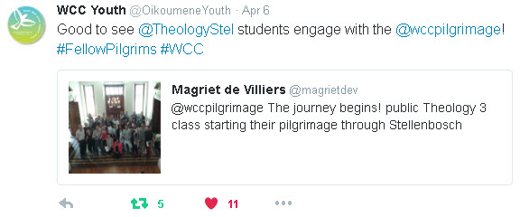
Public Theology for the Public Good: A Blended Teaching and Learning Approach to Theological Education
G) Authentic Learning
SUNlearn as our active learning management system was used throughout:
- Communication
- Reflection
- Assignment
Twitter and the World Council of Churches’ hashtag was used throughout the pilgrimage itself.
Notes:
SUNlearn provided us the necessary base as everything regarding this module is run and administrated via SUNlearn. For this specific intervention we made use of SUNlearn for communication (How, what, when, where, questions); personal reflection (via a Word document that each upload for privacy); the submission of the final assignment
Twitter was used, as one of the big aims of the pilgrimage is the creation of a world-wide community. We invited students to also tweet, but it seems in the end it was just me and Dion! But, having it picked up by the WCC itself an retweeted a few times gave us and the students the knowledge that this was bigger than just the intervention.

Slide 12
Public Theology for the Public Good: A Blended Teaching and Learning Approach to Theological Education
H) Future outlook: mistakes and further learning
Students took many photos but did not engage in the Twitter discussion. If this pilgrimage is applied again more attention could be payed to having the students interact more on this level.
The pilgrimage might also be stretched out over a series of weeks (visit a different ‘public’ each week?)
More time at each 'station' for group conversation, prayer and reflection
The Reflection could have been more structured.
Could have had a closer integration between the classroom learning and the experiential learning
Notes:
I think student’s did not engage mainly due to an uncertainty of what this intervention really entailed. For many of them it was also quite an emotional, even scary experience, one which they did not want to communicate on twitter. It did come out in the reflections.

Slide 13
Public Theology for the Public Good: A Blended Teaching and Learning Approach to Theological Education
H) Future outlook: mistakes and further learning
Needs further reflection by the lecturer and tutor, blended learning coordinator (we are working on this!)
Certainly the development of the Service Learning integration in the various publics (from theory to reflective praxis)
Notes:
I think student’s did not engage mainly due to an uncertainty of what this intervention really entailed. For many of them it was also quite an emotional, even scary experience, one which they did not want to communicate on twitter. It did come out in the reflections.

Slide 14
Public Theology for the Public Good: A Blended Teaching and Learning Approach to Theological Education
Bibliography:
Bozalek, V., Gachago, D., Alexander, L., Watters, K., Wood, D., Ivala, E., & HerringtoN, J. 2013. The Use of Emerging Technologies for Authentic Learning: A South African Study in Higher Education. British Journal of Educational Technology. 44(4): 629-638.
Jacobs, Cecilia & Strydom, Sonja. 2014. From 'Matie' to citizen - graduate attributes as signature learning at Stellenbosch University. The Independent Journal of Teaching and Learning, 9:63-74.
Koopman, Nico. 2010. Some Contours for Public Theology in South Africa. International Journal of Practical Theology, 14(1):123–138
Smit, Dirk J. 2011. The Paradigm of Public Theology - Origins and Development, in Contextuality and Intercontextuality in Public Theology, vol.4, Theology in the Public Square. Berlin: LIT verlag. 11–23.
Smit, Dirk J. 2007. What Does ‘Public’ Mean? Questions with a View to Public Theology, in LD Hansen (ed.) Christian in Public Aims, Methodologies, and Issues in Public Theology. 1st ed. Stellenbosch: SUN press. 11–47.
Tracy, David. 1981. The Analogical Imagination: Christian Theology and the Culture of Pluralism. Religious Studies Review 7, 4: 281–332.
Notes:
I think student’s did not engage mainly due to an uncertainty of what this intervention really entailed. For many of them it was also quite an emotional, even scary experience, one which they did not want to communicate on twitter. It did come out in the reflections.

