Slide 1
Scene Setting: Understanding the Defence Budgeting Process
PRESENTED BY:
RENDANI RANDELA
NATIONAL TREASURY:
Public Finance
21 May 2026
The Security Institute for Governance and Leadership in Africa (SIGLA), Stellenbosch University

Slide 2
Purpose
- Scene setting by way of outlining the budgeting framework and process for public institutions with a special reference to the Department of Defence
Presentation Outline
Medium Term Fiscal Strategy
Overview of the budget framework and process
Defence budget and expenditure
Concluding Remarks: Current challenges and realities

Slide 3
Medium-term fiscal strategy

Slide 4
Medium-term fiscal strategy
Government’s medium-term fiscal strategy aims to stabilise the debt-to-GDP ratio in the current year and to reduce it through the rest of the decade by growing the main budget primary surplus. To execute this, government will, among other things:
  Improve the efficiency of spending by implementing the Targeted and Responsible Savings (TARS) initiative;
  Improve the composition of spending by containing the public-service wage bill while increasing capital investment (infrastructure investment); and
  Entrench sustainable public finances with a principles-led fiscal anchor.

Slide 5
Gross government debt to stabilise at 78.9 per cent of GDP in 2025/26
To stabilise government debt, government policy has focused on achieving a primary budget surplus. For several years, government has indicated that debt is expected to stabilise in 2025/26.
However, government has not set a specific target for the debt-to-GDP ratio, because this indicator is highly sensitive to fluctuations in GDP growth. As economic growth forecasts change, the projected level at which debt stabilises also shifts, making it difficult to commit to a fixed numerical target.
Gross debt-to-GDP outlook

Slide 6
Overview of the Budget Framework and Process

Slide 7
Purpose of the budget
The budget is the key statement of policy of the government and the process through which choices have to be made about competing priorities
Objectives of the budget include achieving: fiscal sustainability, allocative efficiency, value for money and service delivery
Budgeting is a political exercise and ends with political choices about which programmes and projects get funded
The vertical division of revenue shows resources allocated to the three spheres of government to provide for delivery of services including con-current functions
The Constitution provides Parliament with powers to amend the budget – realised through the Money Bills Amendment Procedure and Related Matters Act, 2009

Slide 8
Budget is compiled for three years (MTEF) but revised annually
2026 MTEF
Takes places within the Medium Term Expenditure Framework (MTEF)
2026/27
2027 MTEF
2027/28
2027/28
2028/29
2028/29
2029/30
Notes:
A department may request and motivate for additional resources over the baseline when no funds could be sourced from within the existing baseline (reprioritisation). In each budget, only a small part of total budgeting is subject to active decision making. All budget estimates, down to sub-programme level, are compiled for the full 3-year period.

Slide 9
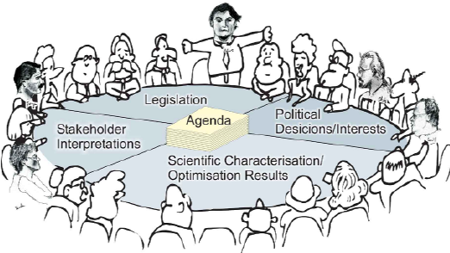
Function budgeting
Government’s priorities are reflected in the Medium-Term Development Plan (MTDP) and National Development Plan (NDP)
The function approach to budgeting allows for proper resource allocation within the expenditure ceiling
Institutions are organised by function for effective comparison of resource allocations with service delivery trends
Discussion are held for changes to delivery models, institutional arrangements and policy frameworks to accommodate spending pressures within budget baselines
Peace and security
Learning and culture
Community Development
Economic Development
Health
Social Development
General Public Services

Slide 10
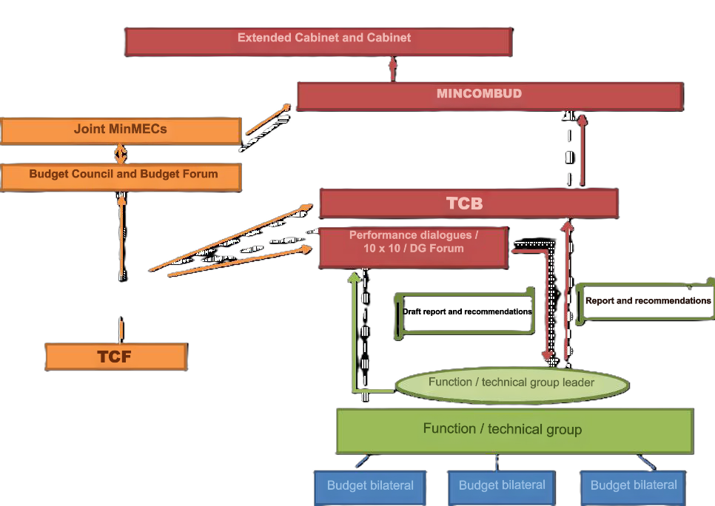
Structures & role of NT
Main role-players
Technical Role of NT
Provide the Fiscal Framework based on the macroeconomic forecast
Propose the Division of Revenue between the 3 spheres
Lead in tax policy proposals
Forecasting Economic policy
Raise funding in markets
Provide technical guidelines to coordinate budget submissions
Coordinate and chair function group meetings
Make recommendations to TCB, Budget Council and Ministers’ Committee on the Budget (who in turn make recommendations to Cabinet and Extended Cabinet)
Prepare and table budget documentation
Brief Parliamentary Committees in respect of budget documentation tabled

Slide 11

Stages of the budget process
TCB/ENE (Formulation)
NT and departments, consultative process
Parliamentary process (Approval)
National Assembly/ NCOP
In-Year Reports (Execution)
Monthly expenditure reports for departments are published on the treasury website Sec 32 (By Dept and Economic classification)
Quarterly SCOA reports
Mid-Year Review (Execution)
Tabled annually after the first six months of the financial year (AENE)
Includes financial and non-financial information
Year-End Reports (Oversight)
Tabled by each department six months after the end of the financial year and available on websites
Formulation
Oversight
Approval
Execution

Slide 12
Post Tabling of the Budget: What does the law say?
The Money Bills Amendment Procedure and Related Matters Amendment Act, 2018 requires that after the tabling of a national budget:
  Section 8(3) – Committees on finance must within 16 days or as soon as reasonably possible thereafter, submit a report to the National Assembly and the National Council of Provinces on the fiscal framework and revenue proposals
  Section 9(3) – The Division of Revenue Bill (DORA) must be passed within 35 days after the adoption of the fiscal framework by Parliament, or a soon as reasonably possible thereafter
  Section 10(7) – Parliament must pass the Appropriation Bill with or without amendments, within four months after the start of the financial year, namely 31 July

Slide 13
Defence Budget and Expenditure

Slide 14
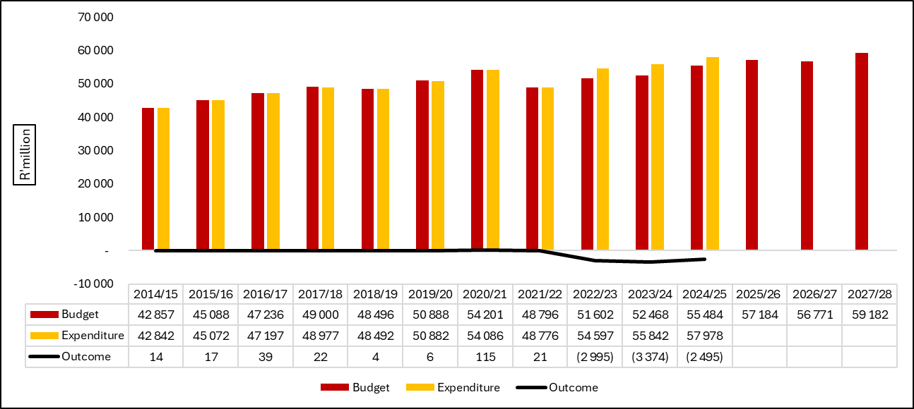
Defence budget and expenditure (1)
DoD's budget grew from R42.9 billion in 2014/15 to R55.5 billion in 2024/25, while expenditure was higher than the budget since 2022/23, driven by high spending on compensation of employees.

Slide 15
Budget allocation by economic classification (2)
65%
23%
12%
The share of CoE in total defence expenditure has increased from 54% in 2014/15 to 65% in 2024/25, diverging significantly from the Defence Review target of 40:30:30 (current ratio: 65:23:12).

Slide 16
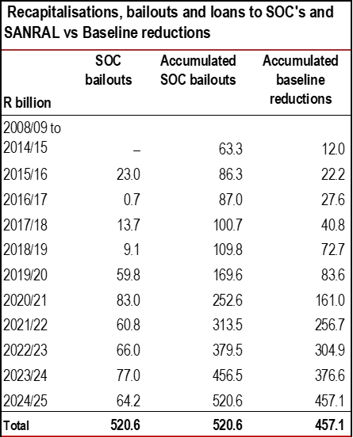
Departmental baselines reduced to fund SOEs bailouts
Over the past decade, requests for bailouts and debt takeovers have cost the fiscus R520.6 billion.
This was financed through baseline adjustments and increased borrowing.
National, provincial and local government baselines have been reduced by an accumulated R457 billion over this period
Spending on infrastructure and essential goods and services took the brunt of the baseline adjustment, directly impacting service delivery.

Slide 17
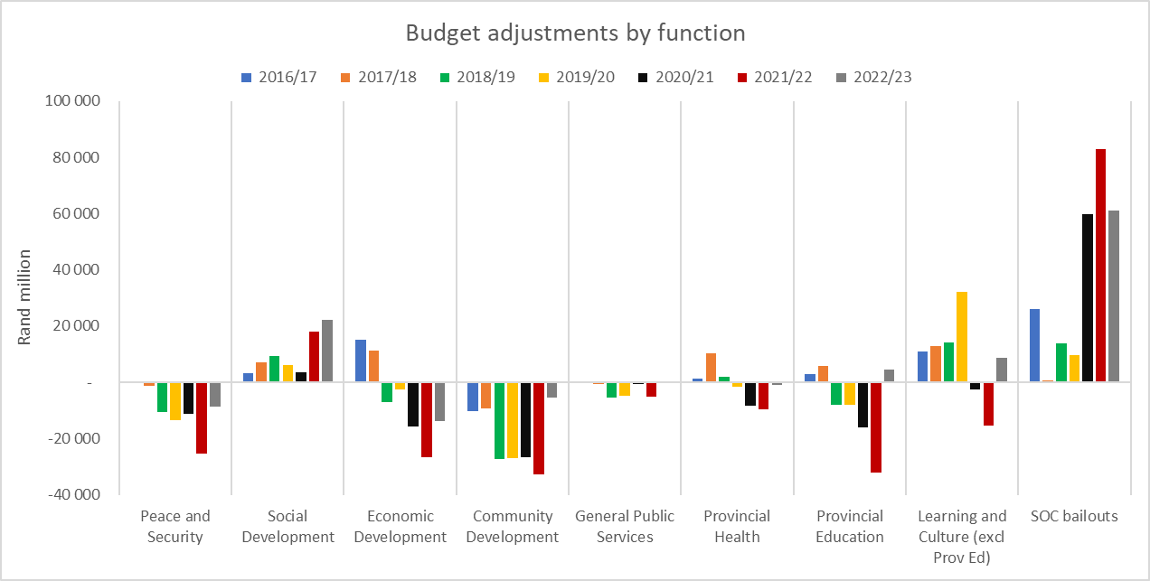
Other sectors suffered while SOEs, grants and fee-free higher education were prioritised
The areas that saw significant reductions include:
Community development (-R139 billion between 16/17-22/23) – human settlements, public transport, basic services, some infrastructure grants.
Peace and security (- R71 billion between 16/17-22/23 – mainly police, defence and correctional services)
Provincial health and education sectors.

Slide 18
CURRENT REALITIES AND CHALLENGES
Constrained fiscal environment and departmental baseline reductions
Dealing with pressure on compensation of employees: Personnel reduction vs rejuvenation
Conditions of service – retirement at the age of 60 while no longer deployable
In dealing with personnel related challenges, what should be career pathways for members to ensure rejuvenation of the Defence Force?
Impact of long and open-ended peace keeping missions on the budget
Increasing ordered commitments in a tight fiscal space
Realignment of the Defence budget to achieve the 40:30:30 ratio between personnel, operations and capital.

Slide 19
THANK YOU

