Slide 1
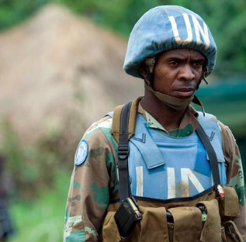
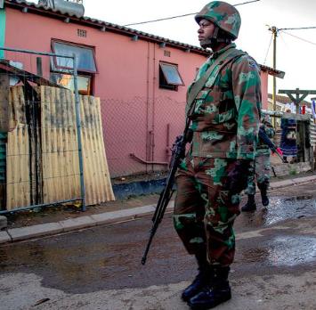
Why defence in South Africa has turned into an underfunded and misaligned portfolio
Theo Neethling
University of the Free State &
Akademia (Paarl)

Slide 2
SANDF: Balancing External Commitments and Domestic Pressures (Post-1994)
Since 1994, South Africa committed to peace, security, and stability in Africa, leading to extensive SANDF participation in multinational peacekeeping operations.
These deployments supported South Africa’s post-apartheid identity as a promoter of human rights, peace, and development.
External operations aligned with the country’s leadership ambitions and moral responsibility on the continent.
However, a declining defence budget and high-tech force design undermined sustainable regional deployment capacity.
Domestically, rising crime levels increased pressure on the SANDF to support the police in crime hotspots.

Slide 3
Force Design vs Operational Reality: The SANDF after 1996
The 1996 White Paper on Defence proposed a high-technology core force, sized for peacetime but expandable for emerging threats.
In 1998, Cabinet approved major equipment acquisitions (the controversial arms deal), including fighter aircraft, trainers, helicopters, corvettes, and submarines.
Critics argued that some acquisitions reflected offensive capabilities, misaligned with South Africa’s peacekeeping-oriented foreign policy.
Official intent: primary role – defend against external threats; secondary role – promote peace and security in Africa.
In practice, the SANDF became a key foreign policy instrument, with major contributions to UN peacekeeping missions (notably in the DRC).
Result: Secondary functions became primary responsibilities.
This shift occurred without additional personnel or equipment, creating capability strain.

Slide 4
Expanding Domestic Roles and Declining Resources
The 1996 White Paper on Defence assigned public order policing primarily to SAPS, not the military.
Due to police shortages, SANDF deployments in support of SAPS increased, especially in crime-related operations.
Military support, ideally limited to extreme situations, became an ongoing domestic activity.
In 2010, the SANDF resumed border safeguarding, covering 4 500 km of land borders and 4 000 km of coastline.
Persistent budget cuts and underfunding weakened capabilities (e.g., defence budget declines since mid-1990s).
Budget constraints reduced serviceability of high-tech equipment (aircraft, frigates, submarines).
By 2023, about 85% of the air force fleet was reportedly non-operational, with similar challenges in the navy.
Result: Expanded responsibilities alongside declining operational readiness and increased vulnerability.

Slide 5
SANDF: Border Control and Domestic Operations Challenges
Since 2023, the Border Management Agency assists the SANDF at ports of entry (land, air, maritime), but support is limited to law-enforcement functions.
Ongoing challenges: Inadequate mobility (land, sea, air); Limited transport capacity; Poor border infrastructure (fences, patrol roads, access routes).
2019: SANDF deployed a battalion to Cape Flats to support communities; welcomed locally but raised debate about military readiness for law enforcement.
Some argue for a gendarmerie to handle routine policing instead of military involvement.
Other domestic operations include: Combating illegal mining syndicates; Preventing commercial truck torchings; Guarding Eskom power plants; Responding to cash-in-transit heists.

Slide 6
SANDF Internal Deployments: Civil Unrest and Crime Response
July 2021 unrest: Violent protests in KwaZulu-Natal and Gauteng following former President Jacob Zuma’s arrest.
Consequences: Widespread looting of shops and businesses; Destruction of public facilities and private property; Significant economic damage.
Recent 2026 deployments (per State of the Nation Address): Support against gang-related crime and violence in the Western Cape; Combat illegal mining operations in Gauteng; Extended to Eastern Cape due to public pressure.
Highlights ongoing dual domestic challenges: civil unrest and organized crime requiring SANDF involvement.

Slide 7
(1) SANDF and Post-1994 Peace and Security Role
Participation in peace and security operations became a hallmark of South Africa’s post-1994 foreign policy.
This led to SANDF deployments in Lesotho, the DRC, Burundi, Sudan, Mozambique, and other smaller external missions.Government aimed to promote human rights, peace and development across Africa.
However, defence policy still prioritised safeguarding sovereignty and territorial integrity.
The South African Defence Review (1998) proposed: A high-technology core forceSized for peacetime, but expandable for emerging threats.
SANDF design focused on its “primary object” (defence)Peace and security operations were to be performed through collateral utility (secondary role)
Problem: Since 1998, the SANDF has increasingly functioned as a foreign policy instrument
Result: Secondary peace support roles have de facto become the SANDF’s primary function.

Slide 8
(2) SANDF Budgetary Constraints Since 1994
Budgetary limitations have increasingly challenged the South African National Defence Force (SANDF) since 1994.
The 2015 Defence Review indicated defence spending of less than 1.2% of GDP, leaving the SANDF approximately 24% underfunded relative to its required size and structure.
In recent years, defence expenditure has fallen below 1% of GDP, with trends approaching 0.5%.
These reductions have raised serious concerns about serviceability and operational functionality.Broader factors include slow economic growth and fiscal pressure, necessitating reduced government spending.
However, South Africa’s defence allocation remains significantly below the global average of 2.2% of GDP.

Slide 9
(3) SANDF Peace & Security Operations: Challenges
Post-1994 focus: Operations in peace and security across Africa.
Key contributions: 5th largest UN troop contributor in eastern DRC; Significant role in SADC operation in northern Mozambique.
Problem: Deployments are often open-ended, causing prolonged missions.
Budget implications: Extended deployments strain the defence budget.
Political expectations remain high for SANDF support in foreign policy, despite unclear mission end-states.
No clear plan to either: increase defence funding, or scale down political ambitions relative to military capacity.
Result: Mismatch between operational demands and resources.

Slide 10
(4) SANDF’s Domestic Role: Challenges & Implications
Border protection and support for SAPS are increasingly treated as primary SANDF functions.
SANDF often used as a stopgap in domestic security, undermining its professionalism and operational mandate.
Result: SANDF is becoming a hollowed-out institution, with strained resources.
Need for stricter parliamentary oversight over internal and external deployments.
Key factors driving domestic deployments:
  Declining SAPS capacity to manage crime and public safety;
  Political reliance on the military as a tool for law enforcement.
Political and community pressures increase demand for SANDF internal operations, sometimes influenced by party-political motivations.

Slide 11
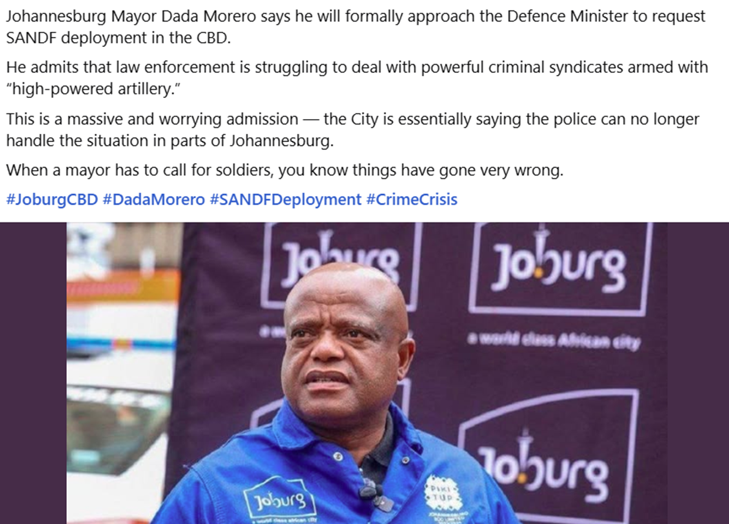

Slide 12
(5) The ongoing “guns versus butter” debate in South Africa
After 1994, South Africa faced massive social and developmental challenges — inequality, unemployment, housing shortages, and service delivery backlogs.
Many policymakers and analysts argued that the country did not face a major conventional military threat.
Therefore, spending heavily on defence might divert resources from urgent domestic priorities.
This created tension:
Pro-“butter” side:
  Argued funds should focus on development and improving living conditions.
  Emphasised social justice and economic transformation.
Pro-“guns” side:
  Argued a capable military is essential for sovereignty, peacekeeping, border protection, and disaster support.
  Warned that underfunding defence weakens readiness and equipment maintenance.
Need for functional lighter and less technological-intensive armed forces, but without abdicating the responsibility for preserving South Africa’s integrity and sovereignty?

Slide 13
Conclusion: SANDF – Expectations vs Capacity
Mismatch between political expectations and SANDF’s budget and capabilities.
Core mandate: defence of South Africa, while also responding to:
  Regional peace and security operations;
  Support to SAPS in crime-ridden areas.
All responsibilities executed with <1% of GDP, straining resources.
Consequence: SANDF is institutionally overstretched and in a state of ongoing decline.
Urgent need to align resources, mandate, and political expectations.

Slide 14
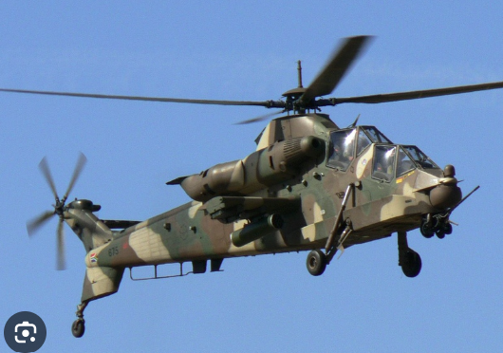
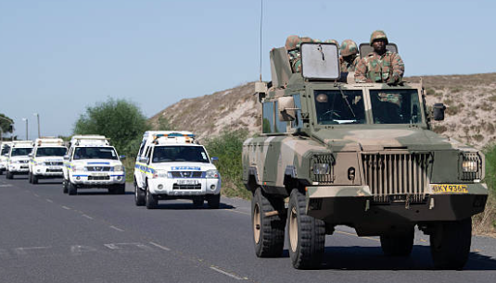
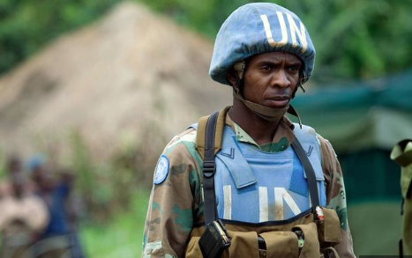
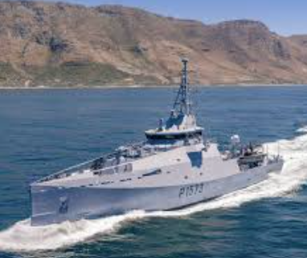
“…jack-of-all-trades type of defence force, and to ensure that the available forces would have the maximum elasticity and flexibility” H-R Heitman

