Slide 1
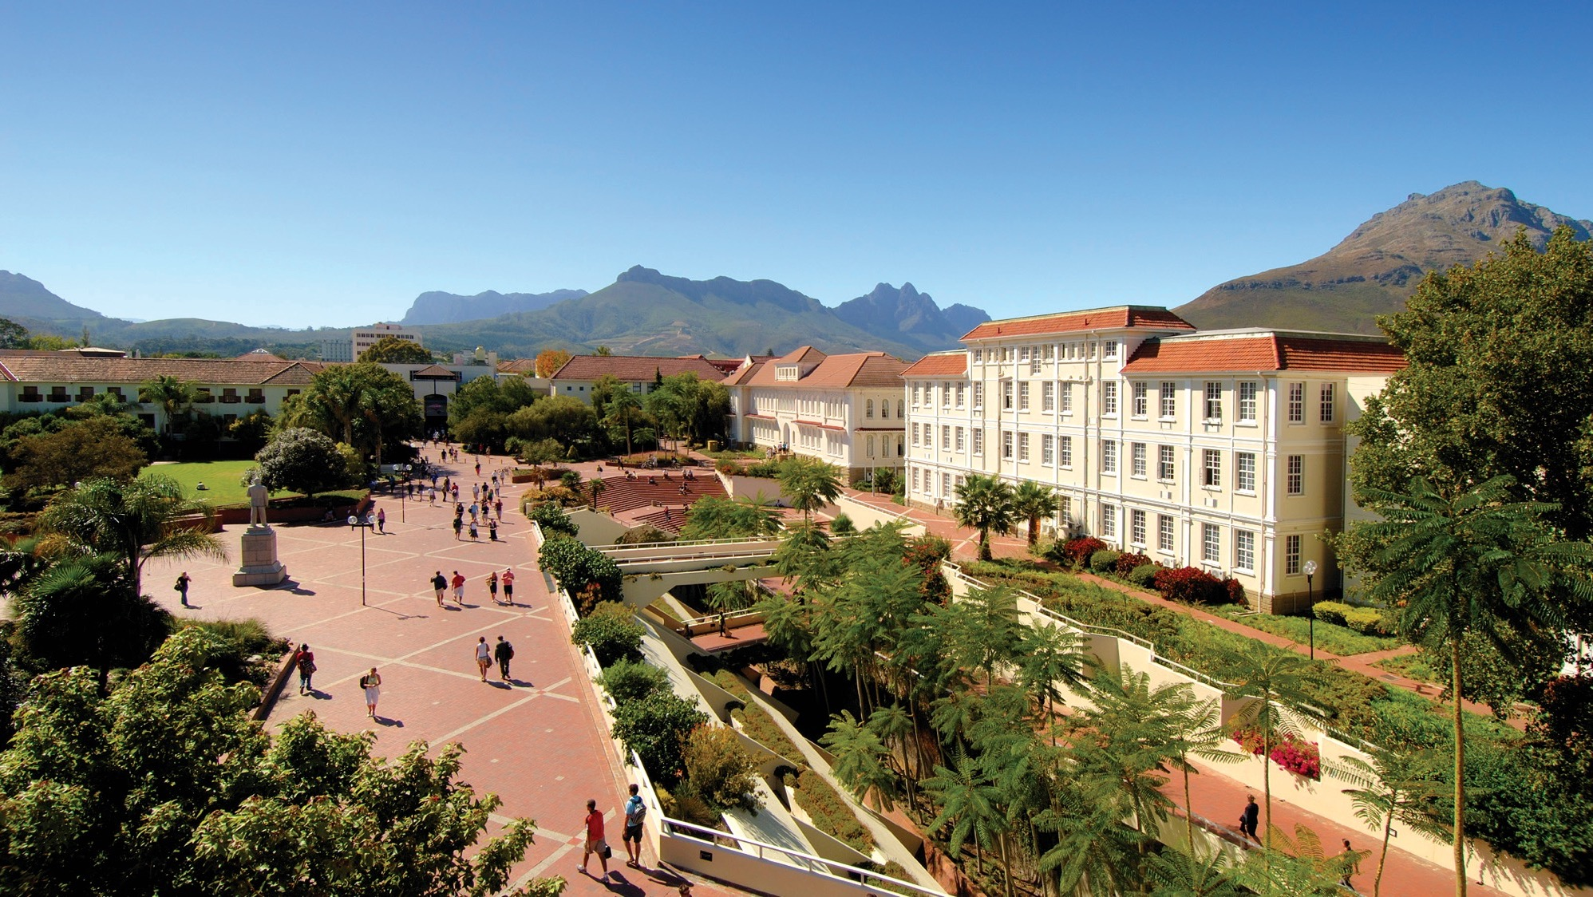
Dr Wilhelm Janse van Rensburg
Research Fellow: SIGLA
Commentary on the 2026 Defence Budget Vote
Notes:
Cover/End slide layout
To change the picture:
Select the picture by clicking on it near the bottom of the slide (under the title placeholder), then click on the Picture Format tab.
Click on the Change Picture icon and choose the From a File/This Device… option.
Browse and select a picture and click on the Insert button.
Use the Crop command to adjust the image.
Click on the Crop command again to apply the changes.
Remember to add image attributions to photographs or artworks.

Slide 2
SCOPE
Following the BRRR approach:
  Looking back on defence expenditure
  High level overview of the current budget (Vote 23)
  Key cost drivers in 2026/27
  Looking forward
Conclusion

Slide 3
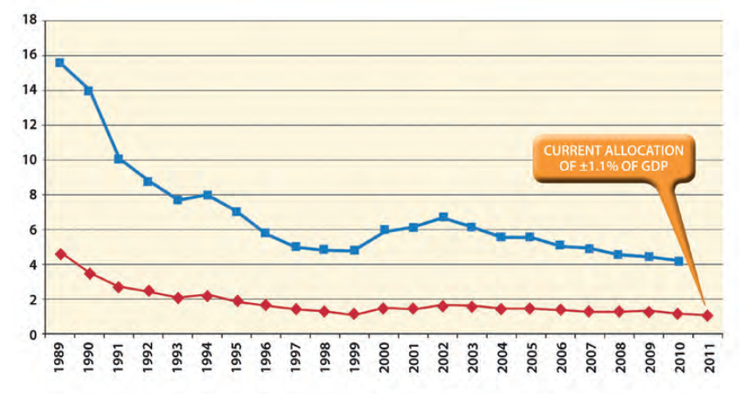
Looking back
Defence expenditure 1989-2011 (2015 DR)
  1998 DR not
  implementable (cuts)
  By 2011, SANDF 24%
  underfunded.
  2015 DR Milestone 1:
  Return to 1,1% of GDP

Slide 4
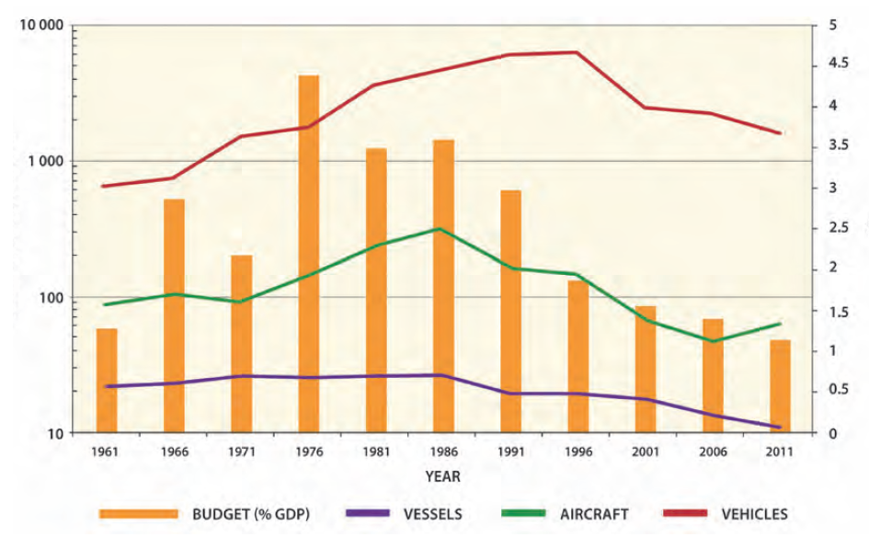
Looking back
Impact on prime mission capabilities/equipment
  Misalignment in spending:
  CoE vs CapEx
  Impact on core
  capabilities

Slide 5
Looking back
Defence expenditure post 2015 DR
  Remained around 0.7% of GDP
  Impacted by:
    Bail-outs for SOE’s
    Free higher education
    Grants
  Milestone 1 of the 2015 DR
  not implemented
2017 Briefing by NT on the 2015 DR:
"The indicated request for additional funding to implement the review was unrealistic, almost doubling the current Defence allocation…
[and]
there seemed to be unwillingness from Defence to implement reforms that could free resources towards the implementation of some of the Defence Review objectives.”

Slide 6
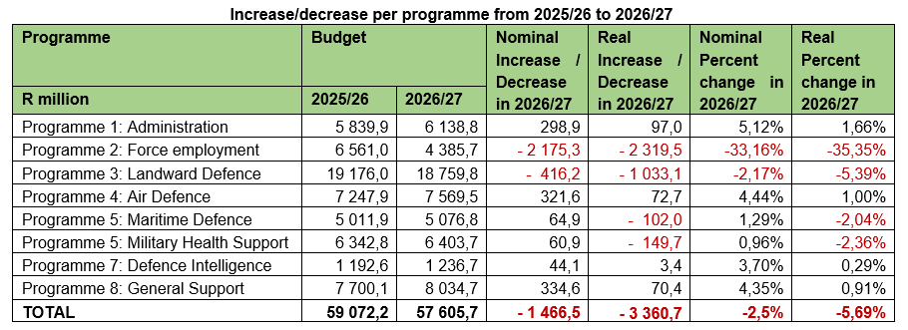
The current defence budget

Slide 7
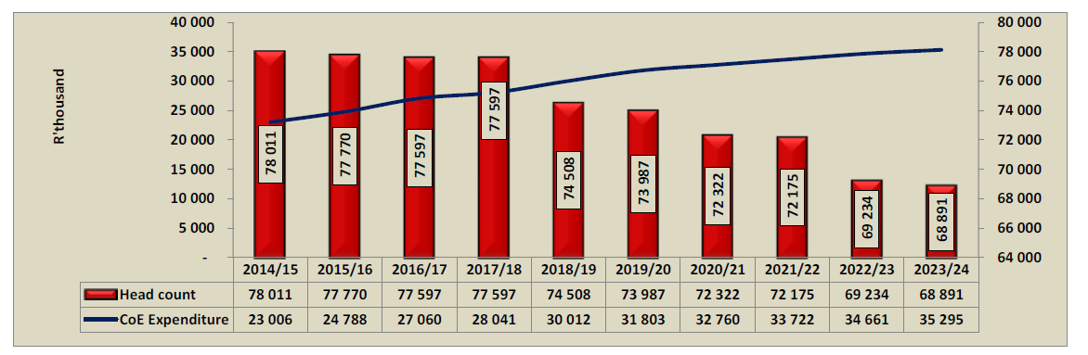
The current defence budget
Primary cost driver: Compensation of Employees (CoE)
R37,7bn for CoE in 2026/27 (likely to be higher; R37,6bn spent in 2024/25)

Slide 8
The current defence budget
Primary cost driver: CoE
  “All departmental baselines were reduced to fund various policies such as the fee-free higher education. Unlike other departments, the DoD did not participate in the DPSA’s initiative to implement early retirement without penalisation of pension benefits…”
  2018 Cabinet decision: CoE ceiling imposed
  2022/23: Parliament secures R1bn for 2022/23 and
  R800m for 2023/24 to fund exit strategy to bring CoE under control
  March 2022: DOD estimates break-even point by 2024/25
  Unauthorised expenditure on CoE remains; expected in 2026/27

Slide 9
The current defence budget
Primary cost driver: CoE
  CoE and rejuvenation – Parliamentary recommendation (2023)
  The Committees therefore recommend that the DOD develops a new Human Resources management strategy or adjust the current strategy to ensure long-term stability in the SANDF’s personnel contingent by focusing specifically on force rejuvenation. It is recommended that this plan be developed in consultation with National Treasury and that the plan be fully funded to achieve the desired outcomes. Of specific importance to this recommendation is that the Strategy should create a permanent exit mechanism for older soldiers who will not advance in their military careers and that such an exit mechanism ensures a smooth transition to civilian life through, for example, vocational training, job placement and/or monetary assistance. The Strategy should be adapted for the unique socio-economic conditions in South Africa on the one hand and be fully aimed at creating long-term force rejuvenation and Compensation of Employees stability in the DOD.
  - Remains unimplemented…

Slide 10
The current defence budget
Other key cost drivers in 2026/27:
  Travel and subsistence: R1,007bn
  Computer services: R1,168bn
  SDA transfers: R3,844bn
  Contractors: R1,543bn
  Property payments: R2,4bn
  Employee social benefits: R243,8m
  Early retirement: R76,1m
  CoE+S&T+Social benefits+Early retirement = 68% (budgeted)

Slide 11
The current defence budget
Income to be generated in 2026/27:
  Rental of Capital Assets: R116.5m
  Services rendered: R391.1m
  Sale of Goods: R15.8m
  Transfers received: R718.7m
  Sale of Capital Assets: R35.0m
  Limited investment in fund generation (Sweating of Assets)

Slide 12
Looking forward
Current MTEF average growth of 1,5% only.
Cabinet approved the new Policy Documents on 6 May 2026:
  Draft Future Defence Policy Concept
  Draft Military Capstone Concept
  Draft Military Strategy 2025-2055 (Journey to Greatness)
Policies yet to be introduced to Parliament
Repeated reference to increased funding to 1,5% of GDP
  The President committed to increasing funding (14 May 2026)
  The President notes “watch this space” but refers to Min of Finance on the matter

Slide 13
Conclusion
Two realities:
  The DOD is underfunded in terms of maintaining a modern, technologically advanced Force
  The DOD shows poor prioritisation and optimisation of existing funding while leadership (political and departmental) shows an unwillingness to make concrete decisions (CoE and IE)
Newly approved defence policies must guide the way forward
  Requires a thorough funding debate and concrete commitments
  May well require realistic adjustments of defence ambitions
  Parliamentary process central to securing a way forward

Slide 14
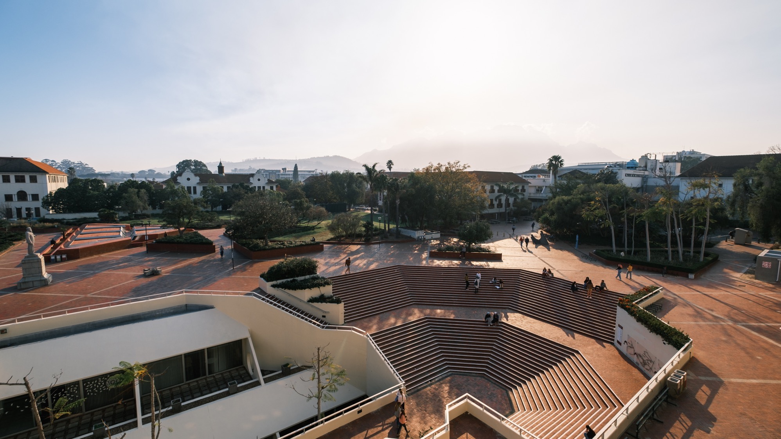
Thank you
Dr Wilhelm Janse van Rensburg wilhelmjvr@gmail.com
Photo by Stefan Els
Notes:
Cover/End slide layout
To change the picture:
Select the picture by clicking on it near the bottom of the slide (under the title placeholder), then click on the Picture Format tab.
Click on the Change Picture icon and choose the From a File/This Device… option.
Browse and select a picture and click on the Insert button.
Use the Crop command to adjust the image.
Click on the Crop command again to apply the changes.
Remember to add image attributions to photographs or artworks.

